Slide 1

Introduction to Missing Data
Denise Esserman, PhD
Professor of Biostatistics
Yale School of Public Health
Denise.Esserman@yale.edu
With support and materials provided by James Dziura, PhD

Slide 2

Missing Data
Definition: Missing data are defined as values that are not available and that would be meaningful for analysis if they were observed.

Slide 3
Outline
What’s the big deal?
Missing data mechanisms
Sensible approaches to handling missing data
Prevention of missing data
Exploring missing data
Analytic strategies – which to use, which to avoid

Slide 4

Missing Data: Example
Kenward and Carpenter. Missing Data in Randomised Trials: A Practical Guide

Slide 5
Missing Data: Example Calcs
Kenward and Carpenter. Missing Data in Randomised Trials: A Practical Guide

Slide 6
Assumption: All unknown outcomes in stent were poor; all unknown outcomes in Angio were good
 | Stent | Angioplasty
No Restenosis | 54 | 73
Restenosis | 56 | 37
OR=2.05 (1.19, 3.53)

Slide 7
Missing Data
With the variability in potential conclusions, it’s hard to believe that studies with a substantial amount of missing data are useful.
  Whether or not can salvage depends on:
    Extent to which we can identify a set of plausible reasons or mechanisms for the missingness
    Degree to which conclusions are robust to the different mechanisms
  Data or consensus opinion from experts may provide information on mechanisms – not definitive
Kenward and Carpenter. Missing Data in Randomised Trials: A Practical Guide

Slide 8

In-class exercises on missing data

Slide 9
Outline
What’s the big deal?
Missing data mechanisms
Sensible approaches to handling missing data
Prevention of missing data
Exploring missing data
Analytic strategies – which to use, which to avoid

Slide 10
Missingness Mechanisms
Missing Completely at Random (MCAR) – the likelihood of missing data is unrelated to observed variables or unobserved values
1
Missing at Random (MAR) – likelihood of missing data is related to observed variables but not to unobserved values
2
Missing Not at Random (MNAR) – likelihood of missing data is related to unobserved values
3

Slide 11
Missing data worksheet examples
 | MCAR | MAR | MNAR
Example 1
Example 2
Example 3

Slide 12
Missing Completely at Random (MCAR)
Probability of missing data on Y is unrelated to the value of Y or any other variables
Pr (Y missing| Y, X) = Pr (Y missing)
Example: Dropped test tube or equipment failure
Equally likely to occur for any patient
Resulting data are a random subsample
Analytic Methods – complete case/listwise deletion
Usual statistical procedures
Loss in sample size = loss in power due to inflated variances and smaller test statistic values
Very strong assumption that is rarely satisfied

Slide 13
Missing at Random (MAR)
Probability of Y missing is unrelated to Y after controlling for other observed variables
Example: in a survey, those who do not report their income are younger on average than those who do
Analytic methods: Likelihood-based; inverse probability weighting; multiple imputation
Pr (Y missing|Y, X) = Pr (Y missing|X)

Slide 14
MAR Example Calc
Asthma study – have baseline FEV₁ and FEV₁ at 12 weeks
  Placebo arm – baseline FEV₁ is 2.05, only 35 out of 92 completed giving 12-week FEV₁ of 2.07
Kenward and Carpenter. Missing Data in Randomised Trials: A Practical Guide

Slide 15
MAR Example Calc
  Low baseline (n=15; 67% miss) – mean FEV₁ =1.861
  High baseline (n=20; 56% miss) – mean FEV₁ = 2.23
Kenward and Carpenter. Missing Data in Randomised Trials: A Practical Guide

Slide 16

Missing Not at Random (MNAR)
Probability of missing data on Y remains related to Y after controlling for other observed variables
  $PR(Y missing|Y,X)≠ \text{PR}\text{ (}\text{Y} \text{missing}\text{|}\text{X}\text{)}$
Example: an alcohol study which records blood alcohol levels every Monday morning. Patients who binge over the weekend and miss their Monday visit have data that are MNAR
  If they came in their blood alcohol level would be high
  Their missing data are directly related to their blood alcohol level
Analytic methods are more complex and involve joint modeling of the outcome and missing data mechanisms

Slide 17
MNAR Example
Patients are MNAR from the placebo arm at 12 weeks if conditional on baseline FEV₁, the chance of their being present at 12 weeks still depends on their FEV₁ at 12 weeks.
Need to either
Describe the statistical relation between the chance of observing a variable and it’s (sometimes unseen) value
Describe how the distribution of data differ among patients with and without missing data
Observed data tell us nothing definitive about these

Slide 18
MNAR Example Calc
Suppose the average FEV₁ of those withdrawn at 12 weeks is 10% less than what MAR would predict. If this is correct we can get sensible estimates for 12-week FEV₁ if we:
  Calculate the average for the missing 57 patients under MAR
  Reduce this by 10%
  Average this with the 35 observed 12- week FEV₁s.

Slide 19

MNAR Example Calc
  Low baseline (n=15) 1.861
  High baseline (n=20) 2.23
Missing Low = 1.861*0.90 =1.6749
Missing High= 2.23*0.90 = 2.007
MNAR estimate:
$$\frac{15∗1.861+31∗1.6749+20∗2.23+26∗2.007}{92}=1.92$$

Slide 20
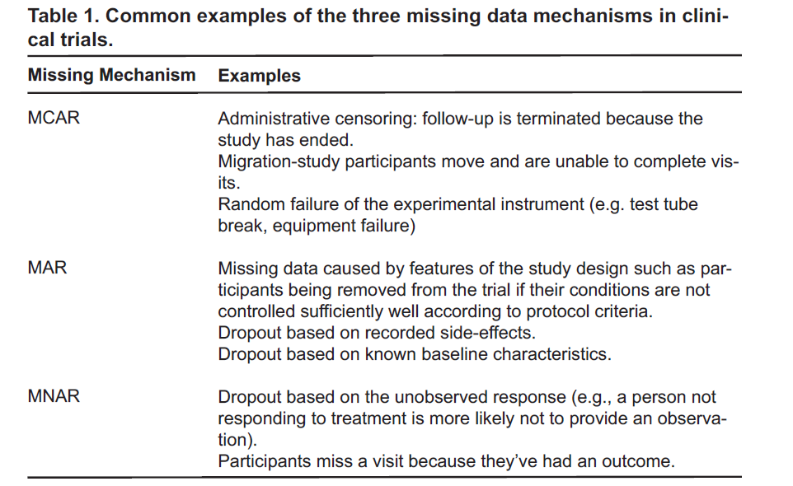

Slide 21
Ignorable Missingness
Do not need to model the relation between the outcome of interest and the probability of missing
  MCAR/MAR are termed ignorable – can ignore (i.e., not model missingness) missing data and get unbiased treatment differences
  MNAR termed nonignorable missingness – can’t ignore the missing data

Slide 22


Can we test the missing data assumption?

Slide 23
What’s the missing data mechanism?
Gender | QOL |  | Gender | QOL
M | 37.25915 |  | F | 34.97452
M | 39.40835 |  | F | 62.15797
M | 41.16343 |  | F | 63.33755
M | 42.59105 |  | F | 63.37772
M | 43.05378 |  | F | 64.12457
M | 43.63327 |  | F | 65.63644
M | 49.73106 |  | F | 65.64179
M | 50.07303 |  | F | 65.69763
M | 50.16646 |  | F | 66.54611
M | 51.85708 |  | F | 73.10746
M | 55.2866 |  | F | 74.39784
M | 55.67153 |  | F | 75.09628
M | 59.72599 |  | F | 79.51964
M | 60.0891 |  | F | 87.37674
M | 60.99173 |  | F
M | 61.20287 |  | F
M | 62.06623 |  | F
M | 62.61082 |  | F
M | 67.67383 |  | F
M |  |  | F

Slide 24
Outline
What’s the big deal?
Missing data mechanisms
Sensible approaches to handling missing data
Prevention of missing data
Exploring missing data
Analytic strategies – which to use, which to avoid

Slide 25
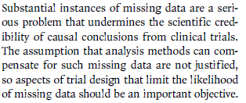

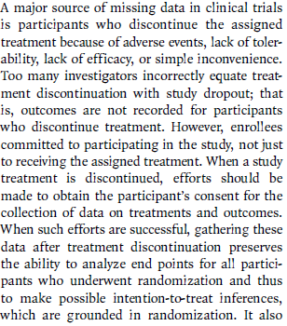
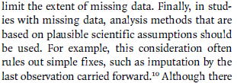
Missing Data
Little RJ, D'Agostino R, Cohen ML, et al. The prevention and treatment of missing data in clinical trials. N Engl J Med 2012;367:1355-1360

Slide 26
NRC Approach to Missing Data
No foolproof way to analyze data. Careful design and conduct to limit the amount and impact of missing data
Analysis that makes full use of information on all randomized participants and is based on careful attention to the assumptions about the nature of the missing data underlying estimates of treatment effects
National Research Council (US) Panel on Handling Missing Data in Clinical Trials.
Washington (DC): National Academies Press (US); 2010.

Slide 27

Prevention of Missing Data
YALE JOURNAL OF BIOLOGY AND MEDICINE 86 (2013), pp.343-358.

Slide 28
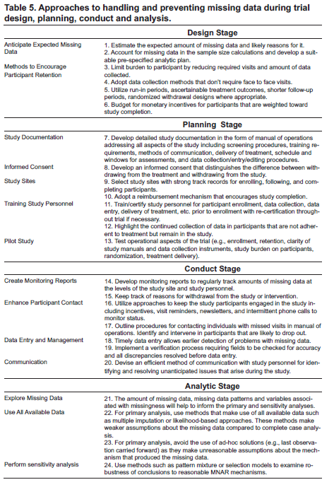

Slide 29
Design Example: Chronic Pain Trial
High rates of missing data from inadequate efficacy and low tolerability. Participants who discontinue usually switch to a proven therapy.
  Use run-in period or randomized withdrawal (pain relief in tolerators/initial responders)
  Use a composite outcome – tolerate and respond to treatment (treatment success rate)
  Flexible dosing to accommodate individual differences in tolerability

Slide 32
ICH E9 – Missing Data
5.3 Missing Values and Outliers
Missing values represent a potential source of bias in a clinical trial. Hence, every effort should be undertaken to fulfil all the requirements of the protocol concerning the collection and management of data. However, there will almost always be some missing data. A trial may be regarded as valid, nonetheless, provided the methods of dealing with missing values are sensible, and particularly if those methods are pre-defined in the protocol. Definition of methods may be refined by updating this aspect in the statistical analysis plan during the blind review. Unfortunately, no universally applicable methods of handling missing values can be recommended. An investigation should be made concerning the sensitivity of the results of analysis to the method of handling missing values, especially if the number of missing values is substantial.

Slide 33
Sensible Analytical Approaches with Missing Data
REMEMBER: There is no definitive analysis in the presence of missing data.
  No definitive way to determine the missing data mechanism unless it’s by design – (e.g., administrative censoring)
General analytic strategy is to conduct an analysis that makes full use of the data on all participants

Slide 34


Sensible Analytical Approaches with Missing Data: Exploration
Exploratory analyses are first approach
  Determine how much missing data and patterns (i.e., what variables are commonly missing together)
  Examine dropout rates, reasons for missing/dropout, and characteristics of missing/dropouts and study completers within and between exposure/treatment arms
  Calculate Kaplan-Meier survival curves to compare time to dropout between exposure/treatment groups and to identify baseline covariates predictive of dropout
  Similar rates/reasons for missing/dropout between exposure/treatment arms increase confidence in conducting ignorable analysis

Slide 35
Missing Data
How much missing data is too much?
  Proportion of missing data alone is not sufficient to indicate study validity
  Minimal missing data – more likely to produce valid conclusions
    Schulz and Grimes
      <5% - usually little impact
      >20% serious flags

Slide 36
4 Data Analytic Strategies
Complete Case Analysis – only subjects with all assessments
  valid under MCAR
Imputation – all available data
  Simple/single (e.g., mean, LOCF)
  Multiple Imputation – valid under MAR
Analysis of Incomplete Data – all available data – likelihood based
  Maximum Likelihood – e.g., EM algorithm or Direct ML
  Valid under MAR
Inverse probability weighting – valid under MAR
All of these are ignorable methods, that is, they do not directly model the relation between the outcome of interest and the probability of missing

Slide 37
Complete Case Analysis
Exclude subjects with any missing data from analysis (listwise deletion).
Utilize typical statistical methods (e.g., chi-square, t-test, ANOVA, regression) on reduced set of data.
Advantages
Easy to implement
Unbiased estimates if MCAR
Unbiased estimates if MAR for independent variables in a regression
Example: In a regression with a dependent variable of body weight and independent variables of education and physical activity (PA), missing PA levels can be dependent on education. As long as missing PA is not associated with body weight, estimates will be unbiased by a listwise deletion.
Disadvantages
Loss of power and precision
Biased if not MCAR (or MAR in case of independent variables)

Slide 38
Imputation
“Filling in” missing values –creates a complete set of data for all randomized subjects by using a rule
  Can then use typical statistical methods as in complete case
Single imputation – impute a single value
  Example Methods
    Simple mean
    Regression (conditional mean) – regress variable with missing data on baseline characteristics, outcomes, treatment, auxiliary vars and then use regression equation to impute missing
    Last/baseline/worst observation carried forward
  Does not capture uncertainty in imputation and underestimates variability leading to anti-conservative test statistics
  The NRC guidelines for missing data state that single imputation methods like “last observation carried forward” should not be used as the primary analytic approach unless the assumptions that underlie these methods are scientifically justified

Slide 39
Last Observation Carried Forward (LOCF)
Missing data is replaced with last observed value for that subject
Used to be Popular - Simple and perceived tendency to provide conservative estimates of treatment effect
Valid only under the assumption that the missing outcomes are equal to the last observed response – very specific and unrealistic

Slide 40
LOCF

Slide 41
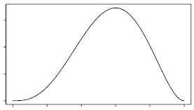
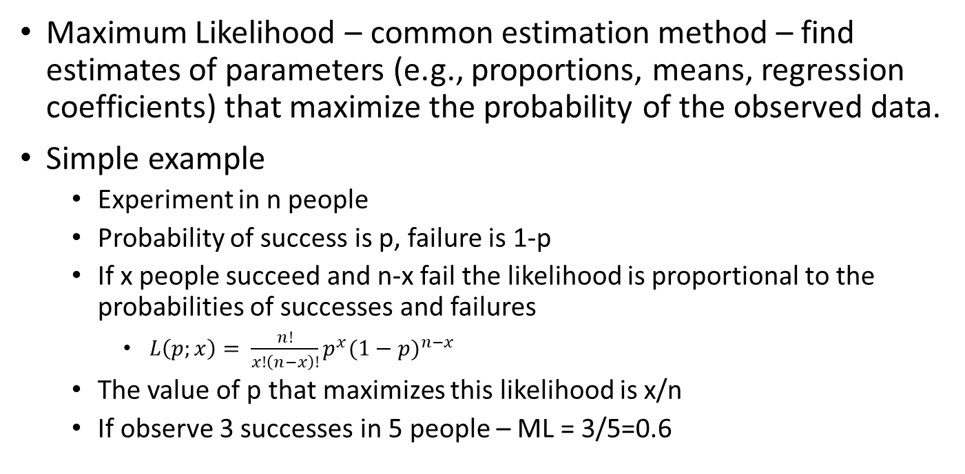
Likelihood Based
Maximum Likelihood – common estimation method – find estimates of parameters (e.g., proportions, means, regression coefficients) that maximize the probability of the observed data.
Simple example
  Experiment in n people
  Probability of success is p, failure is 1-p
  If x people succeed and n-x fail the likelihood is proportional to the probabilities of successes and failures
    $L\left(p;x\right)= \frac{n!}{x!\left(n−x\right)!}p^{x}{(1−p)}^{n−x}$
  The value of p that maximizes this likelihood is x/n
  If observe 3 successes in 5 people – ML = 3/5=0.6
0 0.6 1

Slide 42
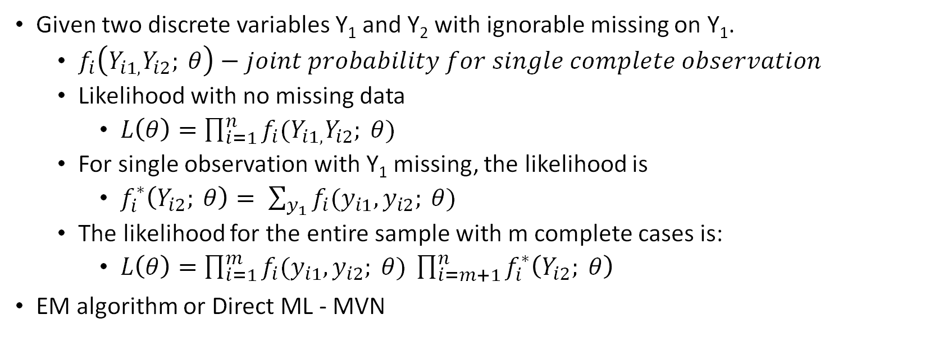
ML for Ignorable Missing Data
Given two discrete variables Y₁ and Y₂ with ignorable missing on Y₁.
  $f_{i}\left(Y_{i1,}Y_{i2}; θ\right)−joint probability for single complete observation$
  Likelihood with no missing data
    $L\left(θ\right)=\prod_{i=1}^{n}{f_{i}(Y_{i1,}Y_{i2}; θ)}$
  For single observation with Y₁ missing, the likelihood is
    $f_{i}^{∗}\left(Y_{i2}; θ\right)= \sum_{y_{1}}{f_{i}(y_{i1},y_{i2}; θ)}$
  The likelihood for the entire sample with m complete cases is:
    $L\left(θ\right)=\prod_{i=1}^{m}{f_{i}(y_{i1},y_{i2}; θ) }\prod_{i=m+1}^{n}{f_{i}^{∗}\left(Y_{i2}; θ\right)}$
EM algorithm or Direct ML - MVN

Slide 43
Likelihood Based
Under MAR – ML averages out the missing data from the joint likelihood of observed and missing data
Future statistical behavior for a subject, conditional upon observed data, is the same whether or not that subject drops out.
Advantages
Use all available data
Under MAR
Unbiased estimates of exposure effect
Unbiased estimates of variance
Disadvantages
Reliance on parametric assumptions
Models and software may not be readily available – good for linear/loglinear models – not for Cox, Poisson, logistic
Mixed - only handles missing outcome data

Slide 44
Study Population Data
Patient | Treatment | Baseline | 1 | 2 | 3 | 4
1 | 1 | 3.00 | 3.00 | 2.99 | 2.99 | 2.99
2 | 1 | 3.00 | 3.00 | 3.00 | 3.00 | 3.00
3 | 1 | 3.00 | 2.99 | 2.95 | 2.90 | 2.88
4 | 2 | 3.20 | 3.10 | 3.10 | 3.00 | 2.90
5 | 2 | 3.00 | 3.00 | 2.80 | 2.80 | 2.70
6 | 2 | 3.00 | 2.70 | 2.50 | 2.10 | 2.00

Slide 45
Study Population Data

Slide 46
Observed Data
Patient | Treatment | Baseline | 1 | 2 | 3 | 4
1 | 1 | 3.00 | 3.00 | 2.99 | 2.99 | 2.99
2 | 1 | 3.00 | 3.00 | 3.00 | 3.00 | 3.00
3 | 1 | 3.00 | 2.99 | 2.95 | 2.90 | Missing
4 | 2 | 3.20 | 3.10 | 3.10 | 3.00 | 2.90
5 | 2 | 3.00 | 3.00 | 2.80 | 2.80 | 2.70
6 | 2 | 3.00 | 2.70 | 2.50 | Missing | Missing

Slide 47
Observed (available) Data

Slide 48
Complete Cases
Patient | Treatment | Baseline | 1 | 2 | 3 | 4
1 | 1 | 3.00 | 3.00 | 2.99 | 2.99 | 2.99
2 | 1 | 3.00 | 3.00 | 3.00 | 3.00 | 3.00
3 | 1
4 | 2 | 3.20 | 3.10 | 3.10 | 3.00 | 2.90
5 | 2 | 3.00 | 3.00 | 2.80 | 2.80 | 2.70
6 | 2

Slide 49
Complete Cases

Slide 50
Last Observation Carried Forward (LOCF)
Patient | Treatment | Baseline | 1 | 2 | 3 | 4
1 | 1 | 3.00 | 3.00 | 2.99 | 2.99 | 2.99
2 | 1 | 3.00 | 3.00 | 3.00 | 3.00 | 3.00
3 | 1 | 3.00 | 2.99 | 2.95 | 2.90 | 2.90
4 | 2 | 3.20 | 3.10 | 3.10 | 3.00 | 2.90
5 | 2 | 3.00 | 3.00 | 2.80 | 2.80 | 2.70
6 | 2 | 3.00 | 2.70 | 2.50 | 2.50 | 2.50

Slide 51
Last Observation Carried Forward

Slide 52
Observed Data: Mixed Model
Patient | Treatment | Baseline | 1 | 2 | 3 | 4
1 | 1 | 3.00 | 3.00 | 2.99 | 2.99 | 2.99
2 | 1 | 3.00 | 3.00 | 3.00 | 3.00 | 3.00
3 | 1 | 3.00 | 2.99 | 2.95 | 2.90 | Missing
4 | 2 | 3.20 | 3.10 | 3.10 | 3.00 | 2.90
5 | 2 | 3.00 | 3.00 | 2.80 | 2.80 | 2.70
6 | 2 | 3.00 | 2.70 | 2.50 | Missing | Missing
Patient 3 had been doing worse than the average patients in treatment group 1. So the mean for treatment group 1 at time 4 should be adjusted to reflect that if patient 3 had not dropped out, their observation at time 4 would likely have been worse than the treatment 1 group average. But the magnitude of the adjustment would be tempered by the fact that subjects in treatment group 1 tended to do better than group 2. Likewise, patient 6 was doing worse than the other subjects in group 2, so the means at times 3 and 4 would be adjusted down to reflect what would have happened if patient 6 remained.

Slide 53
Mixed Model

Slide 54
Visit 4 Differences Between Treatment Groups
 | 4 Week Differences
Population | 0.42
Completers/Available | 0.19
LOCF | 0.26
Mixed | 0.28

Slide 55
Review of Day 1
Mechanisms of Missingness
  MCAR
  MAR
  MNAR
Ignorable Missing
Prevention of Missing Data
  Design
  Planning
  Conduct
Began Discussing Sensible Methods for Missing Data

Slide 56
Example 1: in-class exercise

Slide 57
Ad hoc Method: Missing Indicator for Independent Variables
For continuous variable with missing data, create a Y/N indicator for whether an observation is missing, for each observation with missing impute the mean for that variable using observed cases.
  Use both variables in analysis (e.g., in a regression)
For categorical variable with missing data, create a new level of the variable if it’s missing.
Allison (Missing Data, 2002): This method leads to biased estimates of coefficients

Slide 58
Single Imputation
Mean imputation – for a given variable impute for missing cases the mean of that variable estimated from observed cases
Conditional imputation - for a given variable impute for missing cases the conditional mean (e.g., estimated from regression) of that variable estimated from observed cases
Single random imputation - for a given variable impute for missing cases the conditional mean with random error (e.g., estimated from regression with random error) of that variable estimated from observed cases

Slide 59
Single Imputation Example
Simulated 10,000 observations of x and y from a bivariate normal distribution where the correlation is 0.40; randomly set half of x to missing (i.e., MCAR mechanism)
Mean imputation: the mean of x for observed cases was -0.04
  Set all missing x values to -0.04
Conditional Mean Imputation: regress x on y for observed cases, deterministic part of regression was x=0.02827+0.19968*y
  Set all missing x values to x=0.02827+0.19968*y
Single Random Imputation: regress x on y for observed cases, regression was x=0.02827+0.19968*y + e, where e distributed as normal with mean 0 and sd=9.12303 (i.e., root MSE)
  Set all missing x values to 0.02827+0.19968*y + a random draw from normal with mean 0 and SD 9.12303

Slide 60
Single Imputation Example: Results
 | N | Correlation | Beta | SE(b)
Full Data | 10000 | 0.40 | 0.821 | 0.0185
Complete Case | 5000 | 0.41 | 0.826 | 0.0263
Mean Imputation | 10000 | 0.29 | 0.826 | 0.0276
Conditional Mean Imputation | 10000 | 0.53 | 1.42 | 0.0226
Single Random Imputation | 10000 | 0.41 | 0.833 | 0.0184

Slide 61
Single Random Imputation
Problem 1: Treat the imputed value like all the other observed values, even though we’re uncertain that it’s the correct value
Problem 2: We also assume that the intercept and beta coefficient for the regression of x on y were true parameters, rather than sample estimates
Multiple imputation can accommodate both of these sources of uncertainty

Slide 62
Single Random Imputation
Imputation | Beta Estimate | StdErr
1 | 0.83257 | 0.01841
2 | 0.81820 | 0.01874
3 | 0.81369 | 0.01870
4 | 0.80429 | 0.01857
5 | 0.82453 | 0.01868
Problem 1: Treat the imputed value like all the other observed values, even though we’re uncertain that it’s the correct value
Could solve this by doing the random imputation several times, creating several data sets, estimating the correlation between x and y for each imputed data set, averaging correlation across data sets.

Slide 63

Multiple Imputation
Multiple imputation – generate multiple imputed data sets, analyze each set individually and combine results over datasets
  Imputations are not meant to be actual observations for that individual, but rather a statistically plausible set of values based on other information for that individual
Can be done under MAR and MNAR

Slide 64

Multiple Imputation
Average the beta coefficients: 0.81866
Standard error:
  $SE\left(\overline{β}\right)=\sqrt{\frac{1}{M}\sum_{k}{s_{k}^{2}+(1+\frac{1}{M})(\frac{1}{M−1})\sum_{k}{{(β_{k}−\overline{β})}^{2}}}}$
    = 0.022

Slide 65
Multiple Imputation
Problem 2: We also assume that the intercept and beta coefficient for the regression of x on y were true parameters, rather than sample estimates
For proper multiple imputation, each imputed data set should have different values for the parameters used in imputation
Random draws from the Bayesian posterior distribution
Data Augmentation – algorithm for random draws from posterior (a type of MCMC)

Slide 66
Multiple Imputation: Data Augmentation
MVN model
Step 1: Choose a set of variables for analysis – includes variables (with and without missing) that will be used in analysis of interest. Also should include auxiliary variables (i.e., variables strongly correlated with variables that have missing or associated with probability of missing data). Where you can, transform variables to achieve approximate normality.
Step 2: Get starting values (for MVN these are means and covariances). Could come from complete case analysis or from maximum likelihood (e.g., EM algorithm).
Step 3: Use the current values of the means and covariances to obtain estimates of regression coefficients for equations of each variable with missing data on all observed variables.
Step 4: Use regression estimates to generate predicted values for all missing values adding a random draw from the residual normal distribution for that variable.
Step 5: Use completed data set to recalculate means and covariances .
Step 6: Based on newly calculated means and covariances, make a random draw from their posterior distribution.
Step 7: Using randomly drawn means and covariances, go back to step 3 and continue cycling through to convergence. Once convergence obtained use the imputations on the final iteration as a complete data set.
Allison. Missing Data. 2002.

Slide 67
What if unrealistic to assume MVN?
Sequential Generalized Regression Models
  Instead of a single model assuming MVN, a separate regression model is used for each variable with missing data
    Start with variable with least missing (Y1), regress on fully observed (X) generate imputation for Y1
    Then go to variable with next least amount of missing (Y2), regress on Y1 and X and generate imputation
    Cycle through all variables, then repeat multiple rounds regressing each variable on all others until get stable imputations
    These regressions can vary by dependent variable type
      Linear, logistic, multinomial, poisson
  FCS – fully conditional specification
  MICE – multiple imputation by chained equations

Slide 68
Multiple Imputation: Role of Dependent Variable
Dependent variable should be used to impute missing values of independent variables
Should we impute data on the dependent variable:
If have auxiliary variables that are strongly correlated with dependent and/or have missing independent:
YES
If no missing data on predictors and no auxiliary variables:
NO, imputation will only increase sampling variability

Slide 69

Multiple Imputation: Complications
Using multivariate normal for non-normal data
  Not a big problem for variables with no missing data – not imputing anything for them
  Also pretty good evidence that robust to violations of MVN for non-normal data with missing
    NOTE: If the dependent variable is non-normal should use a different imputation strategy (we’ll discuss later)
  Consider transformations prior to imputation– log, logit etc.
  Dummy variables for categorical
Non-linearities
  Interactions/polynomials – if you suspect an interaction in the analytic model, then need to have interaction in imputation

Slide 70
Multiple Imputation
Advantages
Use all available data
Can handle both missing outcome and covariates
Under MAR
Unbiased estimates of exposure effect
Unbiased estimates of variance
Disadvantages
Doesn’t give a unique exposure effect
Imputation model needs to be compatible with the analysis model
The imputation model can be more complex, but analysis model cannot contain variables that are not in the imputation model

Slide 71
MI or ML Under MAR: Which to Use
Scenario 1 - Regression Model with Missing Data on the Dependent Variable Only:
  Complete case analysis is equivalent to ML
  If have a good auxiliary variable could consider ML or MI
Scenario 2 – Missing Data on Independents Only
  MI – can also incorporate auxiliary variables
  ML with software that uses FIML (e.g. MPLUS)
Scenario 3 – Missing Data on Dependent and Independent
  MI
  ML with software that uses FIML (e.g. MPLUS)
Scenario 4 – Repeated Measures Regression with Missing Data on the Dependent Variable Only
  ML - Mixed Model
  If have a good auxiliary variable can incorporate into ML but could consider MI
Allison PD. Handling Missing Data by Maximum Likelihood. SAS Global Forum 2012.

Slide 72
NRC Recommendations
Recommendation 14: When substantial missing data are anticipated, auxiliary information should be collected that is believed to be associated with reasons for missing values and with the outcomes of interest. This could improve the primary analysis through use of a more appropriate missing at random model or help to carry out sensitivity analyses to assess the impact of missing data on estimates of treatment differences. In addition, investigators should seriously consider following up all or a random sample of trial dropouts, who have not withdrawn consent, to ask them to indicate why they dropped out of the study, and, if they are willing, to collect outcome measurements from them.
Recommendation 15: Sensitivity analyses should be part of the primary reporting of findings from clinical trials. Examining sensitivity to the assumptions about the missing data mechanism should be a mandatory component of reporting.

Slide 73
Example 2

Slide 74
Example Write Up of Missing Data Section
Timely data entry combined with quarterly missing data reports will trigger protocols for tracking and obtaining missing data. Despite these efforts, it is reasonable to assume missing data will occur. Therefore, our primary analysis technique (mixed models) is valid under an MAR assumption, which allows us to use all available longitudinal follow-up data in the model even if an individual is missing some follow-up time points and is a weaker assumption than missing completely at random (MCAR), which only allow use of all complete data. We will evaluate the plausibility of this assumption by determining the extent of missing data, exploring the patterns of missing data, and identifying factors associated with missing data using logistic regression. We plan to assess the robustness of the results under a missing not at random (MNAR) assumption using pattern mixture models as a sensitivity analysis. We will also consider inverse probability weighting to account for missing data, if necessary.

Slide 75
Methods for MNAR
Selection Models – Focus on mechanism by which data become missing (i.e. selected for observation) -after taking account of all information about the missingness mechanism from the observed data, need to consider how missingness mechanism depends on unseen data
  Pr(Y,R)=Pr(Y)Pr(R|Y)
    Where R is a 0/1 indicator of missing
  First consider how probability of missing data depends on observed variables.
  Then further consider how probability of missing data might depend on the unseen measurement – eg. in asthma study those with lower FEV₁ may be less likely to be observed

Slide 76
Methods for MNAR
Pattern Mixture Models – focuses on differences in the distribution of data for those with and without observed data (i.e. is the pattern of data the same in patients with and without missing data)
  Pr(Y, R)=Pr(Y|R)Pr(R)
    Where R is a 0/1 indicator of missing
    Pr(Y|R=1)Pr(R=1) + Pr(Y|R=0)Pr(R=0) – mixture of dist for 2 patterns
  Estimate treatment effects for those that do and do not have missing data (see MNAR example calc)
  Average (mix) these estimates to get an overall estimate

Slide 77
Pattern Mixture Models with Multiple Imputation
First, generate imputations under an ignorable assumption.
Modify the imputations using a transformation
E.g., missing observations are 10% higher then observed
Repeat the process by modifying transformation

Slide 78
Example in R code

Slide 79

Inverse Probability Weighting
Origins in sample survey research
Method:
  Estimate probabilities of being observed based on baseline characteristics, treatment group
  Weight completers in analyses by the inverse of the probability of having data – i.e. give higher weight in the analysis to those with a low probability of observation
Does not use all available data

Slide 80
Sensible Analytical Approaches with Missing Data
Explore missing data – amount, patterns and relations to observed variables
Use all available data assuming the missing data mechanism is ignorable with proviso if not ignorable then more complex methods will be required.
  Sensible MAR analysis - likelihood or MI methods recommended accounting for covariates predictive of missingness
Conduct sensible sensitivity analyses under MNAR

Slide 81

Generally Inappropriate Analytic Methods with Missing Data
Complete case – excludes anyone with missing data
  Assumes MCAR
  Even if MCAR is true, it is inefficient – lower sample size and reduced power
  Typical of many SAS procedures
Single Imputation
  Unless satisfy very strong assumptions will be biased – LOCF, simple mean
  Underestimate variance leading to artificially low p-values
    LOCF are perfectly correlated and underestimate variance leading to artificially low p-values

Slide 82
NRC Recommendations
Recommendation 1: The trial protocol should explicitly define (a) the objective(s) of the trial; (b) the associated primary outcome or outcomes; (c) how, when, and on whom the outcome or outcomes will be measured; and (d) the measures of intervention effects, that is, the causal estimands of primary interest. These measures should be meaningful for all study participants, and estimable with minimal assumptions. Concerning the latter, the protocol should address the potential impact and treatment of missing data.
Recommendation 2: Investigators, sponsors, and regulators should design clinical trials consistent with the goal of maximizing the number of participants who are maintained on the protocol-specified intervention until the outcome data are collected.
Recommendation 3: Trial sponsors should continue to collect information on key outcomes on participants who discontinue their protocol specified intervention in the course of the study, except in those cases for which a compelling cost-benefit analysis argues otherwise, and this information should be recorded and used in the analysis.
National Research Council (US) Panel on Handling Missing Data in Clinical Trials.
Washington (DC): National Academies Press (US); 2010.

Slide 83
NRC Recommendations
Recommendation 4: The trial design team should consider whether participants who discontinue the protocol intervention should have access to and be encouraged to use specific alternative treatments. Such treatments should be specified in the study protocol.
Recommendation 5: Data collection and information about all relevant treatments and key covariates should be recorded for all initial study participants, whether or not participants received the intervention specified in the protocol.

Slide 84
NRC Recommendations
Recommendation 6: Study sponsors should explicitly anticipate potential problems of missing data. In particular, the trial protocol should contain a section that addresses missing data issues, including the anticipated amount of missing data, and steps taken in trial design and trial conduct to monitor and limit the impact of missing data.
Recommendation 7: Informed consent documents should emphasize the importance of collecting outcome data from individuals who choose to discontinue treatment during the study, and they should encourage participants to provide this information whether or not they complete the anticipated course of study treatment.
Recommendation 8: All trial protocols should recognize the importance of minimizing the amount of missing data, and, in particular, they should set a minimum rate of completeness for the primary outcome(s), based on what has been achievable in similar past trials.

Slide 85
NRC Recommendations
Recommendation 9: Statistical methods for handling missing data should be specified by clinical trial sponsors in study protocols, and their associated assumptions stated in a way that can be understood by clinicians.
Recommendation 10: Single imputation methods like last observation carried forward and baseline observation carried forward should not be used as the primary approach to the treatment of missing data unless the assumptions that underlie them are scientifically justified.
Recommendation 11: Parametric models in general, and random effects models in particular, should be used with caution, with all their assumptions clearly spelled out and justified. Models relying on parametric assumptions should be accompanied by goodness-of-fit procedures.

Slide 86
NRC Recommendations
Recommendation 12: It is important that the primary analysis of the data from a clinical trial should account for the uncertainty attributable to missing data, so that under the stated missing data assumptions the associated significance tests have valid type I error rates and the confidence intervals have the nominal coverage properties. For inverse probability weighting and maximum likelihood methods, this analysis can be accomplished by appropriate computation of standard errors, using either asymptotic results or the bootstrap. For imputation, it is necessary to use appropriate rules for multiply imputing missing responses and combining results across imputed datasets because single imputation does not account for all sources of variability.
Recommendation 13: Weighted generalized estimating equations methods should be more widely used in settings when missing at random can be well justified and a stable weight model can be determined, as a possibly useful alternative to parametric modeling.

Slide 87
