Slide 1

Accelerating Impact:
Immersive Summer Bootcamp in Implementation
Science and Biostatistics
Georgian Implementation Science Fogarty Training (GIFT) Program
Ilia State University & Yale University

Slide 2
Categorical Data

Slide 3
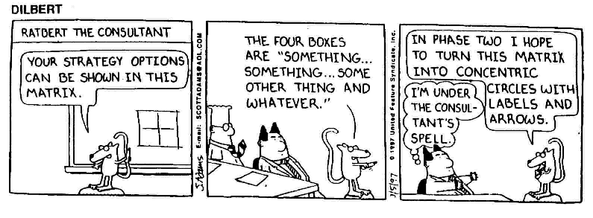

Slide 4

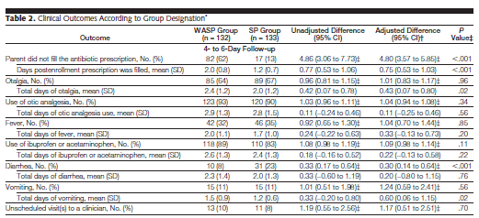

Slide 5
Measures of Association
Indicate the strength of the relation between 2 variables (example. recurrence and treatment)

Slide 6
In a prospective study to assess the relationship between smoking and the subsequent risk of lung cancer, a cohort of 2000 people were followed.
 | Lung Cancer | No Lung Cancer
Smoking | 450 (A) | 150 (B) | 600 (A+B)
No Smoking | 150 (C) | 1250 (D) | 1400 (C+D)
 | 600 (A+C) | 1400 (B+D) | 2000 (n)

Slide 7
Binary Outcome

Slide 8
Measures of Association
Prospective Studies
Risk Ratio

Slide 9
Measures of Association
Prospective Studies
Risk Difference
Number Needed to Treat (NNT)
  How many subjects do we have to treat to prevent 1 recurrence

Slide 10
Measures of Association
Prospective Studies
If risk difference is reversed
  Absolute Risk Increase (ARI)
Number needed to harm (NNH)
  How many patients do we need to treat to observe 1 recurrence

Slide 11
Measures of Association
Prospective Studies
Odds Ratio – the odds in one group compared to the odds in another group
  Example

Slide 12
Measures of Association
Case Control Studies
Since we select subjects based on “disease status”, ª/_{a+b} and ^{c}/_{c+d} are meaningless

Slide 13
Measures of Association
Case Control Studies
Estimate an exposure OR
The flexibility of the OR across study designs as well as its benefits in multivariable analyses makes it an attractive and much utilized measure

Slide 14
OR Approximates RR When Rare Disease
If rare disease,
  a is small relative to b
  c is small relative to d

Slide 15
Confidence Interval for RR
When expected cell frequencies are >5 then we can use large sample approximation

Slide 16
Confidence Interval for RR
95% CI for Example
95% sure this interval covers the true population RR

Slide 17
Confidence Interval for OR
95% CI for Example

Slide 18
An OR > 1 means:
Controls had the same exposure as cases
Controls were not selected correctly
Cases were more likely to have had the exposure of interest
Exposed individuals developed disease at a greater frequency

Slide 19
Hypothesis Testing for Contingency Tables
In the 2X2 table, the probability of recurrence:
P(R) = 314/792 =0.40

Slide 20
Hypothesis Testing for Contingency Tables
If there is no relation between treatment and recurrence – expect 40% recurrence for treatment A and 40% recurrence for treatment B

Slide 21
Chi-square Test of Independence
Under the assumption of independence
  For each cell, we calculate the expected number of counts under the assumption of independence

Slide 22
Chi-square Test of Independence
These expected counts are what would have happened if independence was true (i.e. if trt not related to recurrence)

Slide 23
Chi-square Test of Independence
Compare observed to expected
Compare chi-square statistic to critical chi-square:

Slide 24
Chi-square Test of Independence
From table of critical chi-square values (p 356)
  Reject Null

Slide 25
Assumptions for Chi-square Test of Independence
Random and independent sampling of subjects
All cells should have expected counts > 5
  If don’t satisfy – use Fisher’s exact test

Slide 26
Evaluation and Adjustment for Confounding
Example – investigation of maternal tranquilizer use and the risk of malformation
  Smoking is associated with increased risk for malformation
  Tranquilizer users are more likely to smoke

Slide 27
Evaluation and Adjustment for Confounding
Stratum-specific OR
1.44
3.70
3.66

Slide 28
Mantel-Haenszel Odds Ratio
Summary OR that adjusts for a confounder

Slide 29
Mantel-Haenszel Odds Ratio
OR_{MH} (common odds ratio) is valid under the assumption that the stratum-specific ORs are similar
  Can test this using the Breslow-Day Test for Homogeneity of Odds Ratios

Slide 30
MAYBE AN R EXAMPLE HERE Chi-square and MH

Slide 31
Multiple Logistic Regression
Used to evaluate the relation between a binary outcome and multiple independent variables of all types
Example – an ED wants to identify using a number of different variables, which patients were most likely to have a BAC>50 mg/dl

Slide 32
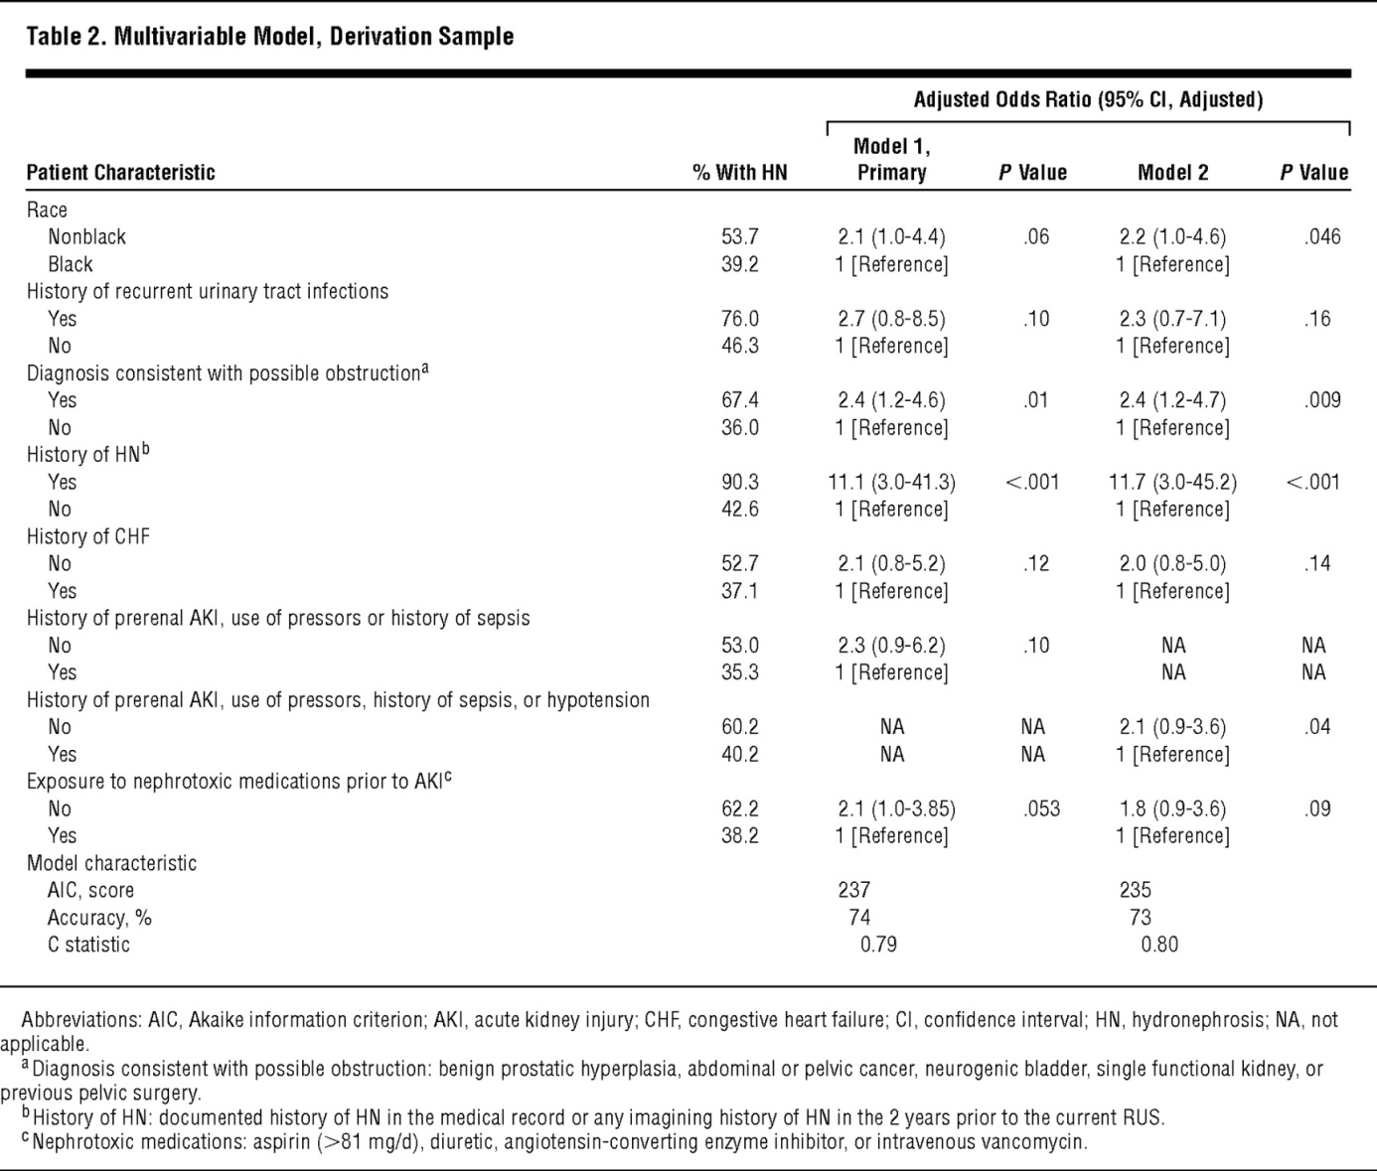

Multivariable Model, Derivation Sample
Licurse, A. et al. Arch Intern Med 2010;170:1900-1907.
Copyright restrictions may apply.

Slide 33
Multiple Logistic Regression
The probability of observing a particular outcome is defined as:
Using the logistic regression results in straightforward model interpretation

Slide 34
Multiple Logistic Regression
Interpretation
  Example 1– let x₁ be a 0/1 indicator of gender
    0=M; 1=F
    ln(odds_{M})=β₀+β₁(0)=β₀
    ln(odds_{F})=β₀+β₁(1)=β₀+β₁

Slide 35
Multiple Logistic Regression
Interpretation
  Example 2– let x₁ be a continuous variable such as age
    β_{age}=0.083
    OR for a 40y compared to a 25y old

Slide 36
Multiple Logistic Regression
Parameters are estimated using maximum likelihood (as opposed to least squares)
CI for OR
Hypothesis Test – Wald statistic
  H₀: β₁=0

Slide 37
MAYBE AN R EXAMPLE HERE LOGISTIC REGRESSION

