Slide 1
Sample Size for Cluster Randomized Clinical Trials
Denise Esserman, PhD
Professor of Biostatistics
Yale School of Public Health

Slide 2
Topics Covered
Review of Basics of Sample Size Calculations
Cluster Randomized Designs
  Parallel Group
  Parallel with Baseline Measure
  Stepped Wedge
  Individually Randomized Group Treatment (IRGT)

Slide 3
Goal of Sample Size
Determine appropriate number of subjects for a given study design
WHY?
Too small – may not be able to answer question
Larger than necessary – more difficult and costly
May reveal design not feasible OR different predictor or outcome is needed
WHEN?
As EARLY as possible

Slide 4
What goes into a sample size calculation?
State the null hypothesis and either a one- or two-sided alternative.
1
Select the appropriate statistical test based on the type of predictor and outcome variable in the hypotheses
2
Choose a reasonable effect size (and variability, if necessary)
3
Set the type I error and power of the study (α and 1-β)
4

Slide 5
Research versus Statistical Hypotheses
Research Hypothesis:
Usually describes what you expect to find, e.g., what the investigator suspects the relationship truly is among the variables being studies
Closely related to the alternative hypothesis (used for sample size calculations)
Statistical Hypothesis (to be tested)
Usually referred to as the null hypothesis (what study trying to disprove)
NOTE: A clear research hypothesis tells the statistician which “null hypothesis” you would like to test and how to frame the “alternative hypothesis” of interest

Slide 6
One vs. two-sided statistical hypotheses
One-sided: specifies the direction of the association between the predictor and outcome variables
Only appropriate in select circumstances
Two-sided: states only that an association exists
Most of the time, both sides of the alternative are interesting

Slide 7
Good Hypotheses
Simple, specific, stated in-advance
Leave no ambiguity about subjects, variables, how test will be applied
Concise operational definitions that summarize the nature and source of subjects and how variables will be measured
Minimize opportunity for testing something different once the study findings have been examined.

Slide 8
What goes into a sample size calculation?
State the null hypothesis and either a one- or two-sided alternative.
1
Select the appropriate statistical test based on the type of predictor and outcome variable in the hypotheses
2
Choose a reasonable effect size (and variability, if necessary)
3
Set the type I error and power of the study (α and 1-β)
4

Slide 9
Type I and Type II Errors
Association Exists
No Association
CORRECT (Power) | TYPE I ERROR (false positive)
TYPE II ERROR (false-negative) | CORRECT
Reject
Null
hypothesis
Fail to Reject
Null hypothesis
Type I and Type II errors can NEVER be avoided completely
Need to establish maximum Type I and Type II error willing to accept
Reducing Type I or Type II error increases sample size

Slide 10
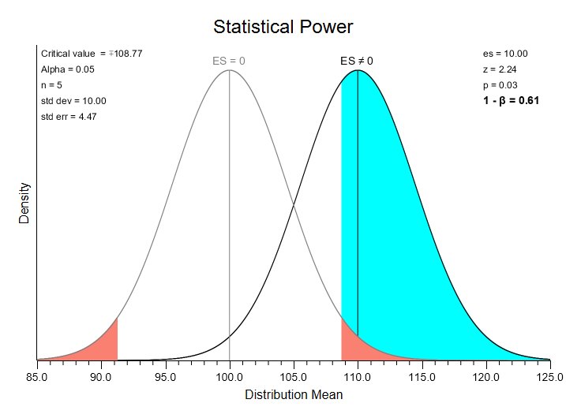
https://sites.berry.edu/vbissonnette/index/stats-homework/documentation/illustrate-statistical-power/

Slide 11
Seriousness of Errors
Guilty
Innocent
CORRECT (Power) | TYPE I ERROR (false positive)
TYPE II ERROR (false-negative) | CORRECT
Convict
Do not Convict
Better to set a guilty person free than send an innocent one to jail

Slide 12
What goes into a sample size calculation?
State the null hypothesis and either a one- or two-sided alternative.
1
Select the appropriate statistical test based on the type of predictor and outcome variable in the hypotheses
2
Choose a reasonable effect size (and variability, if necessary)
3
Set the type I error and power of the study (α and 1-β)
4

Slide 13
Effect Size
Definition: Size of the association expected to be present in the sample
The likelihood that a study will be able to detect an association between a predictor and outcome variable in a sample depends on the actual magnitude of that association in the population
  Large: easy to detect
    E.g., change in systolic blood pressure of 30 mmHg
  Small: difficult to detect
    E.g., change in systolic blood pressure of 2 mmHg

Slide 14
How to determine the effect size?
Most difficult aspect of sample size planning
WHY? → Don’t usually know the magnitude of the association (that’s the purpose of the study)
Determining effect size for sample size calculation
Data from prior studies
Small pilot study
Informed guess
Smallest effect size that is clinically meaningful

Slide 15
Effect sizes for fixed sample size
When the number of subjects is fixed, may have to work backwards to determine the effect size (or power) able to detect
When?
  Limited by availability or affordability
  Secondary data analysis

Slide 16
Effect Sizes for Multiple Outcomes
Calculate the sample size using the effect size for the primary hypothesis
- Can then estimate effect sizes for secondary/tertiary hypotheses based on sample size
OR
If all hypotheses are of equal importance, sample size should be based on whichever hypothesis needs largest sample (accounting for multiple testing)

Slide 17
Variability
Not just the size of the effect, but the variability of the effect also matters
  ↑ variability in outcome → ↑ likelihood of overlap between groups → ↑ difficulty in demonstrating a difference
Larger variability → Larger Sample size

Slide 18
What goes into a sample size calculation?
State the null hypothesis and either a one- or two-sided alternative.
1
Select the appropriate statistical test based on the type of predictor and outcome variable in the hypotheses
2
Choose a reasonable effect size (and variability, if necessary)
3
Set the type I error and power of the study (α and 1-β)
4

Slide 19
Type of statistical test
Must decide on statistical approach to analyzing data before calculating sample size
  Depends mainly on distribution of the outcome (e.g., normal, binomial) and type of predictor (i.e., continuous, categorical)
  Examples:
    Simple methods: two-sample t test, paired t test, chi-square test
    More complicated methods: linear regression, logistic regression
    Even more complicated methods: repeated measures ANOVA, mixed models
      NOTE: Most often, the more complicated the method, the more parameters and information you will need to inform the calculation

Slide 20
Inflations to Sample Size
Losses and dropouts = inflate by 1/(1-loss rate)
Inflating sample size for losses doesn’t solve the missing data problem – still have missing data
Multiplicity = Bonferroni correction to type I error
E.g., 3 treatment groups = 3 comparisons = α /3
E.g., 2 primary outcomes = 2 treatment comparisons, one for each outcome = α /2
Bonferroni is conservative – wouldn’t necessarily use this in the analysis to control for multiplicity
Interim looks for efficacy/futility = 3 to 5% inflation
Impact of nonadherence on estimated effect size

Slide 21

Generic sample size formula
Type I error
Type II error/Power
$N≈$ $\frac{{\left(Z_{1−α/2}+Z_{β}\right)}^{2}σ^{2}}{∆^{2}}$
Variability
Effect Size

Slide 22
Sample size for study designs: Cluster Randomized Designs (CRTs)

Slide 23
Advice
Whenever possible – use an individually randomized trial
  Cluster randomized trials are often more complex
  Cluster randomized have smaller sample sizes (sample size is number of clusters, not number of individuals in cluster)
    Have to address and account for impact of small sample size in analysis
  Randomization may not balance on baseline covariates
But if need to use a cluster randomized design – it is important to choose the best one and know how to design appropriately

Slide 24
Misconception about CRTs
CRTs better suited for evaluating an intervention in “real-world” practice
  Generalizability is not tied to a design, but the representativeness of the sample
Obtaining informed consent not needed in CRTs
Cluster randomization should be used whenever there is the risk of contamination
Davis-Plourde K, Yu X, Teresi JA. Designing Cluster Randomized Trials: A Practical Guide for Investigators. Med Care. 2026 Apr 1;64(4):179-191. doi: 10.1097/MLR.0000000000002283. Epub 2026 Feb 24. PMID: 41733160; PMCID: PMC13288263.

Slide 25
Contamination
Contamination: Participants in the control condition likely to receive the intervention (or components of the intervention)
Cluster randomization is often advocated to minimize contamination
  Should use individual randomization if possible!
  Try to mitigate risk and measure potential impact of contamination
Need to assess whether it is real or just theoretically possible
Impact of contamination
  Biases the treatment effect towards the null (increases chance of Type II error)
  Assess impact – tradeoff between increased sample size due to reduced effect size versus potentially increased complexity AND sample size due to cluster randomization
Contamination in trials: is cluster randomization the answer?: https://pmc.ncbi.nlm.nih.gov/articles/PMC1119583/
Notes:
Note: impact of contamination needs to exceed 30% for cluster trial to be more efficient

Slide 26
“In many ways the design of a study is more important than the analysis. A badly designed study can never be retrieved, whereas a poorly analysed one can usually be reanalysed. Consideration of design is also important because the design of a study will govern how the data are to be analysed.”
https://www.bmj.com/about-bmj/resources-readers/publications/statistics-square-one/13-study-design-and-choosing-statisti

Slide 27
Pragmatic trial designs (PCTs)
“Although PCTs do not necessarily require a specific design approach, both the kinds of questions PCTs are designed to answer and the settings in which they take place may tend to favor certain approaches, such as cluster randomization. The nature of the interventions PCTs seek to test, which may involved healthcare delivery changes, might be better implemented through randomization at the practice, clinic, or even hospital level.”
https://rethinkingclinicaltrials.org/chapters/design/experimental-designs-and-randomization-schemes/statistical-design-considerations/

Slide 28

Why is study design particularly important to biostaticians?
The study design lays the foundation for collecting, analyzing, and interpreting data in a way that produces valid, reliable, and reproducible results.
The quality of the study design directly impacts the statistical analysis and ultimately the conclusions that can be drawn from the study.
Your analysis is as good as your data.
Image source: OpenAI. (2024). Generated by ChatGPT. https://www.openai.com/

Slide 29
Some Design considerations
Experimental vs. Quasi-Experimental Design
Types of Comparisons
  Within-site
    Quasi-Experimental (e.g., pre-post; interrupted time series)
  Between-site
    Randomization at the level of implementation of the intervention (avoid contamination) (e.g., cluster)
  Within- and between-site
    Cross-over type Designs (e.g., Stepped Wedge; Waitlist Control)
Types of Randomization
  Simple
  Stratified
  Covariate Constrained
  Individually Randomized vs. Cluster Randomized vs. Partially Clustered
Treatment
  Combination of treatment vs. Monotherapy
  Sequenced Treatments vs. Un-sequenced
  Patient preference for treatment vs. No Allowance

Slide 30
Quasi-experimental designs
Pre-Post Designs
Non-equivalent Control group
  Capitalize on naturally occurring experiments
  Threats to internal validity – no “equivalent” control group
    Mitigate through selection of control, matching, propensity score methods
  Regression to mean (e.g., if a site was selected because it was underperforming then would see improvement regardless of the intervention)
  Qualitative methods can help to uncover factors affecting results
Interrupted Time Series
  Good when cannot identify a comparable control group (e.g., policy mandates)
  Pre- and post-intervention data are collected
  Defining pre- and post-intervention period can be challenging
  Need to collect sufficient data points across time
  Need to worry about confounding from other interventions that may also be implemented

Slide 31
Designs to Discuss
Parallel group cluster randomized designs
Parallel group cluster randomized with a baseline measure
Stepped-Wedge Designs
Individually Randomized Group Treatment Trials
“Own” Design

Slide 32
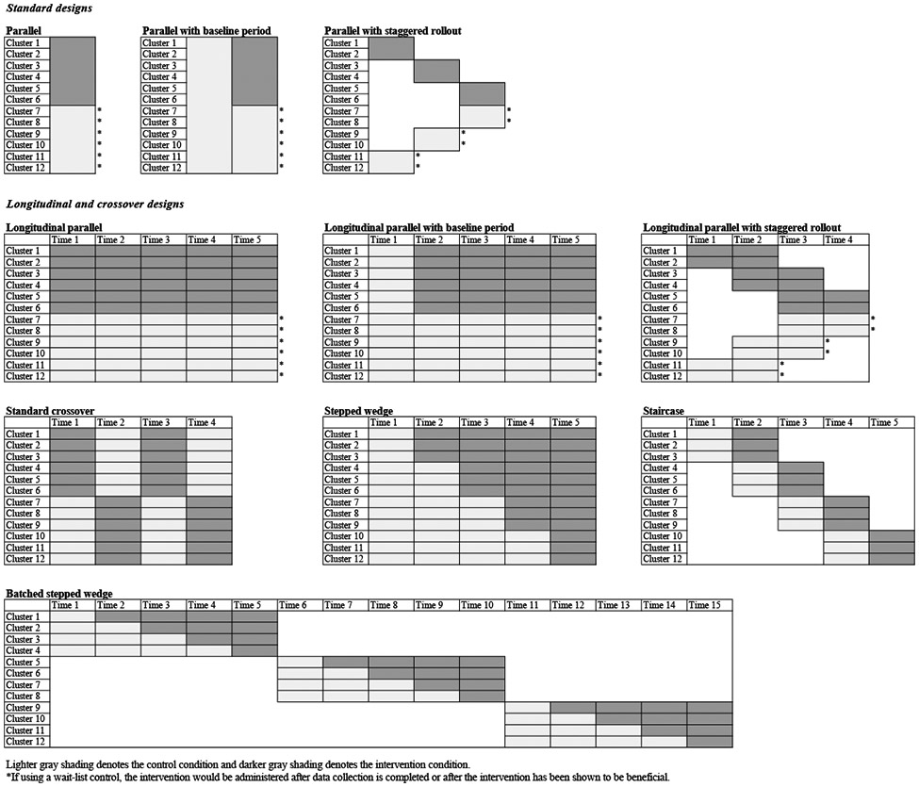
Figure 2: Davis-Plourde K, Yu X, Teresi JA. Designing Cluster Randomized Trials: A Practical Guide for Investigators. Med Care. 2026 Apr 1;64(4):179-191. doi: 10.1097/MLR.0000000000002283. Epub 2026 Feb 24. PMID: 41733160; PMCID: PMC13288263.

Slide 33
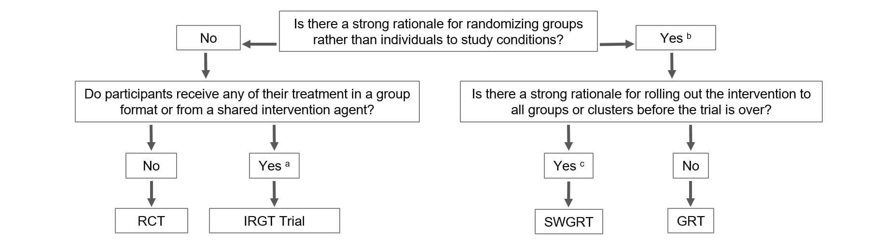
Choosing a Design
RCT: Randomized Controlled Trial
IRGT: Individually Randomized Group Treatment Trial
GRT: Parallel Group or Cluster-randomized Trial
SWGRT: Stepped-Wedge Group- or Cluster-randomized Trial
https://researchmethodsresources.nih.gov/Calculators#grt

Slide 34
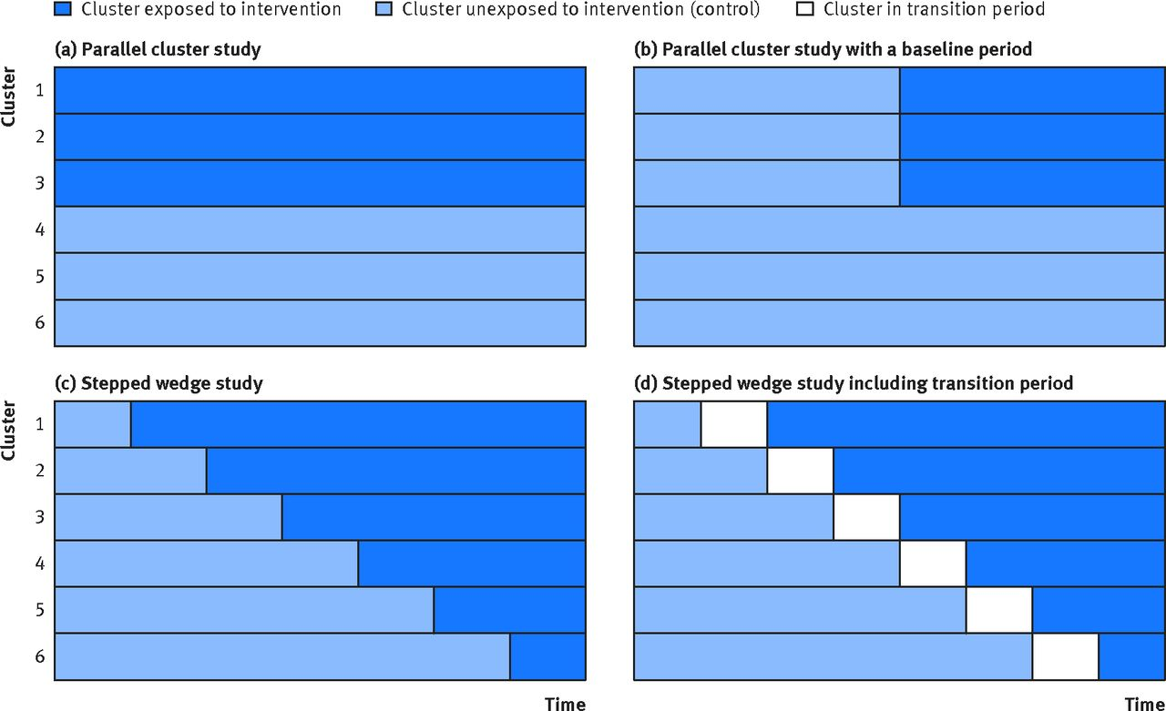
Parallel Group Design
https://www.bmj.com/content/350/bmj.h391

Slide 35
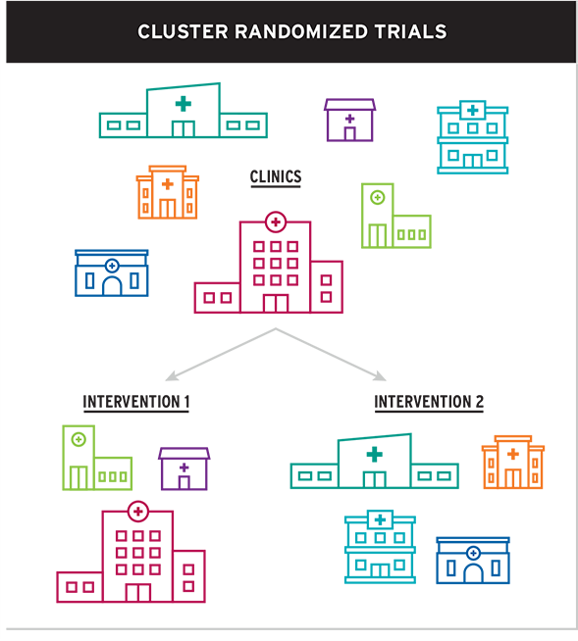
Cluster Randomized Trial (CRT)
Groups of subjects (not individuals) are randomized
Used when cannot randomize individuals due to nature of the intervention and/or potential contamination
Often introduce added level of complexity
Larger sample size needed
Need an estimate of the ICC (intraclass correlation)
  Measures how similar individuals are within a cluster
Can end up with multiple levels of clustering
  Example: Classrooms nested within schools and children nested within classrooms

Slide 36
Correlation Structures
Dependent on the hypothesis being tested, will need to obtain additional parameters for sample size estimation and make assumptions
  Correlation – what is the correlation between repeated measurements over time
  What is the assumed correlation structure – this has an impact on sample size estimation
    Formula on previous slide assumes compound symmetry – but we could make other assumptions
Compound Symmetry/ Exchangeable
Autoregressive (decay model)
Unstructured

Slide 37
Cluster randomized design
Advantages
Disadvantages
Evaluation of interventions that cannot be delivered at the individual level
Address potential contamination
Mirror more closely how interventions are implemented at scale.
Greater design (and analysis) complexity
Larger sample size
Potential for baseline imbalance (depending on sample size)
https://extranet.who.int/kobe_centre/sites/default/files/pdf/WHO%20Guidance_Research%20Methods_Health-EDRM_4.3.pdf

Slide 38
Example
An investigator is designing a cluster randomized clinical trial to compare two treatments for improving HIV prevention knowledge in at risk youth. The primary outcome of interest is a knowledge score measured at 6 months post intervention. The investigator expected to have an average of 25 youth per site. They believe that a 3-point change on the knowledge score represents a clinically meaningful difference and that prior work with the scale has observed a standard deviation of 9.8. What sample size is needed if we want to power for 90% with a two-sided type I error of 5%. You asked about ICC, but the investigator is not sure.

Slide 39
Impact of ICC
Due to ICC, total sample size for cluster randomized trial is larger than individually randomized trial
  Design effect = 1+(m-1)*ρ
    ρ = ICC
    m = average size of the cluster
Example: Suppose for an individually randomized trial you needed 150 individuals. If the ICC was 0.05 and the cluster size was 20, then you would need
  150*[1+(20-1)*0.05] = 150*1.95 = 292.5 →294 (almost double)
Even small ICCs can have substantial impact on the sample size

Slide 40
Example
An investigator is designing a cluster randomized clinical trial to compare two treatments for improving HIV prevention knowledge in at risk youth. The primary outcome of interest is a knowledge score measured at 6 months post intervention. The investigator expected to have an average of 25 youth per site. They believe that a 3-point change on the knowledge score represents a clinically meaningful difference and that prior work with the scale has observed a standard deviation of 9.8. What sample size is needed if we want to power for 90% with a two-sided, type I error of 5%. Assume an ICC of 0.05 from prior work.

Slide 41
NIH Sample size calculation
https://researchmethodsresources.nih.gov/Calculators#grt
Pros:
  The calculator has good descriptions helping to explain the parameters that are needed.
  Can download the output
Con:
  Does not allow variation in parameters during inputs – so would have to enter information multiple times for comparisons
    Some sensitivity in the output
Notes:
Note worked examples!

Slide 42
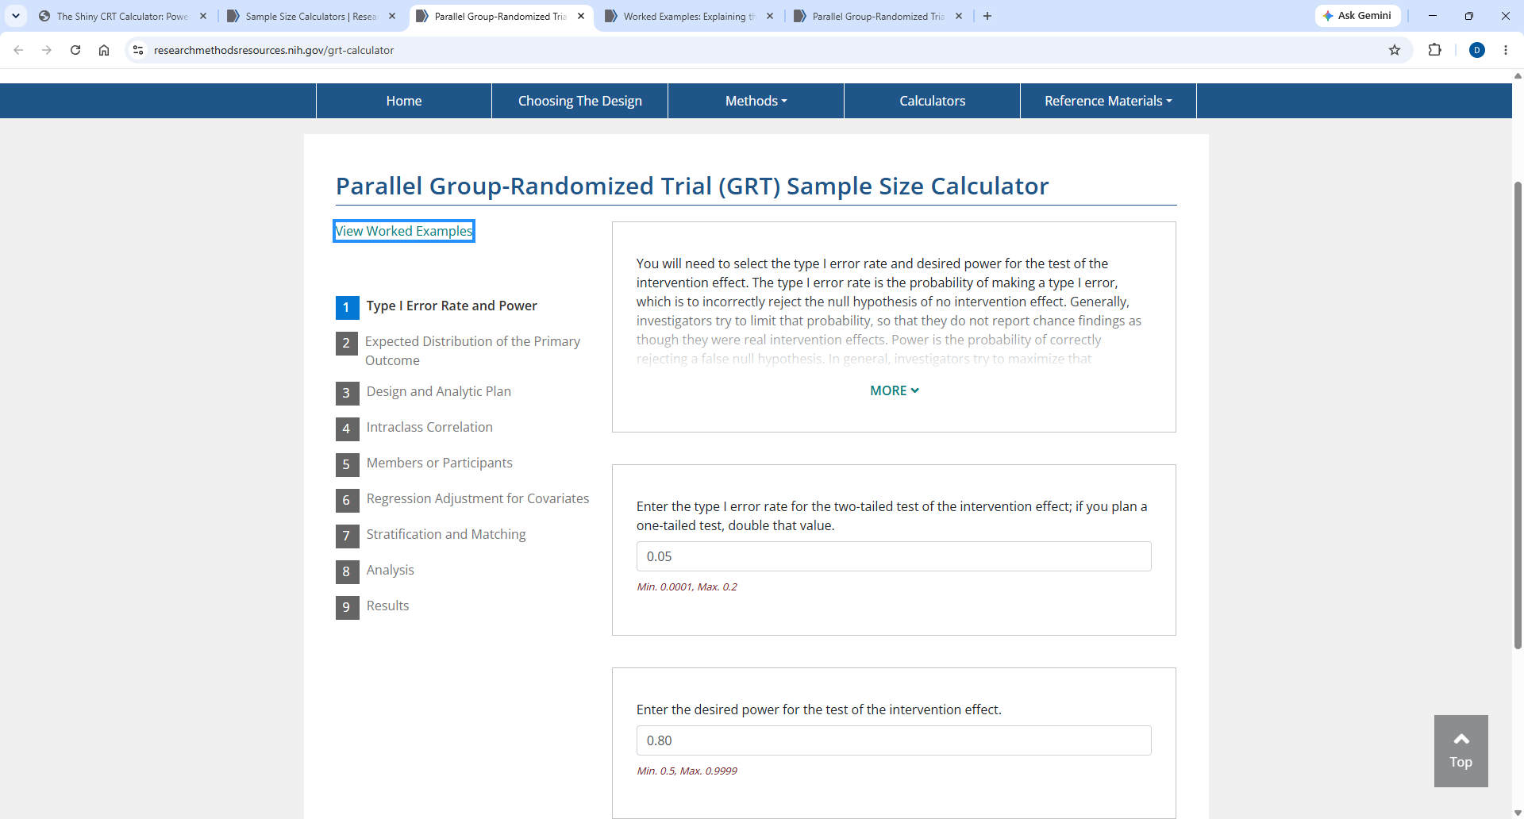
What is needed for Parallel GRT Calculator?

Slide 43
Example:
Step 1: Type I Error Rate and Power
  Type I error: 0.05 (two-sided)
  Power: 0.9
Step 2: Expected Distribution of Primary Outcome
  Distribution: Continuous
  Variance: 9.8² = 96.04
Step 3: Design and Analytic Plan
  Analysis of simple difference
    Plan to compare the two group at 6-months

Slide 44
Example (cont)
Step 4: Intraclass Correlation
  Need the ICC for the primary outcome – assume 0.05
Step 5: Members or Participants
  Expected number per group – assume fixed 25 (so no for variation)
  If think that there will be variation, should get an idea of the variability of cluster size to report coefficient of variation (SD/Mean)
Step 6: Regression Adjustment for Covariates
  No – but if plan to include, then need to know number of degrees of freedom for group level covariates, and some information about the proportion of variability that will be explained (member level and group level)

Slide 45
Example (cont)
Step 7: Stratification and Matching
  No, but can consider a priori matching or stratification or post hoc stratification
Step 8: Analysis
  Specify the effect size hoping to detect: difference of 3
Step 9: Results
  Get the final results
    Some sensitivity analyses around the group numbers and the members per group
    Can download a doc or xls output so can reproduce

Slide 46
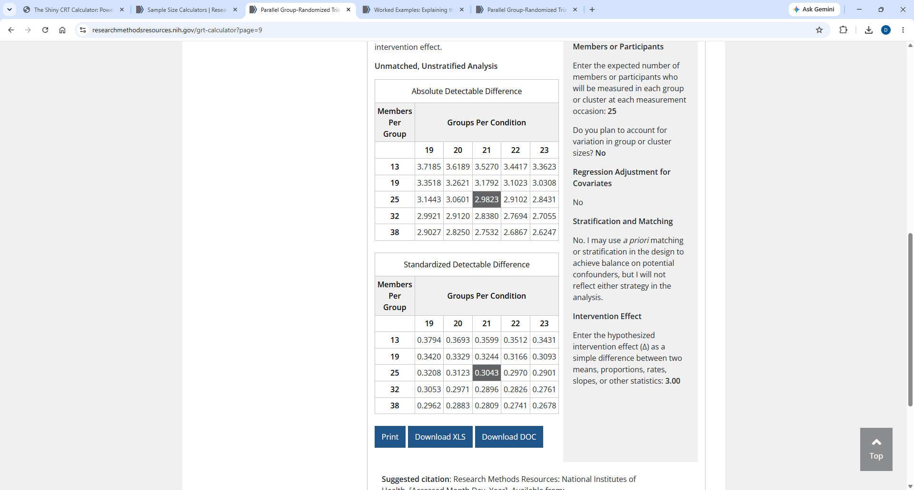
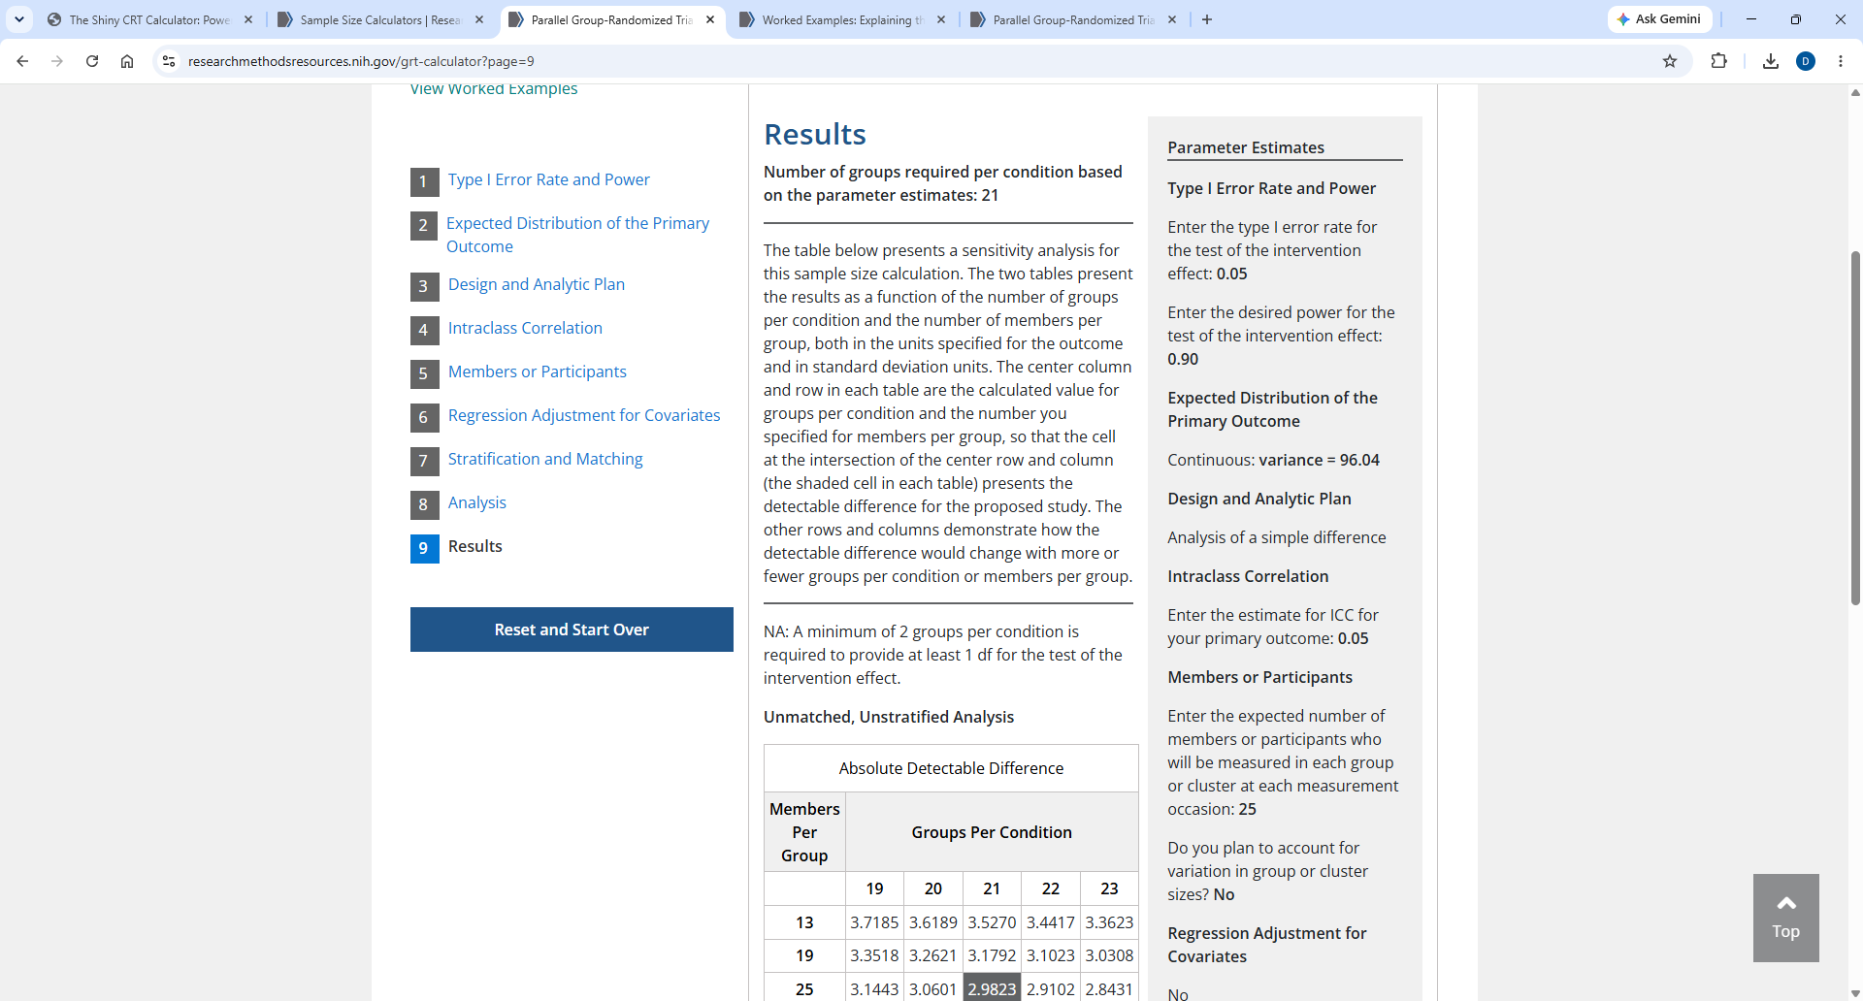
Results

Slide 47
Coefficient of Variation of Cluster Sizes
Suppose you are planning to recruit 16 clinics in and “enroll” all HIV positive patients for a CRT
The following are the cluster sizes:
22, 26, 17, 20, 20, 22, 16, 18, 21, 27, 23, 14, 23, 19, 17, 24
Mean cluster size is 20.6
SD cluster size is 3.6
CV=SD/Mean = 0.17
In general, a higher CV increases the required sample size and impacts statistical power
Primary assumption to assume equal number of participants per cluster

Slide 48
Your turn…
Play around with some of the assumptions:
What happens to number clusters needed when :
  Keep everything constant (only vary one parameter at a time)
    Vary the ICC
      Try 0.01 and 0.1
    Vary the coefficient of variation (CV) for the group size
      Consider 0.25 and 0.5
      Allow for Regression adjustment
        Assume going to adjust for site and have 3 sites = 2df
        Do not know variance so conservative is 0 for both group and member
        Suppose group level variance component explained is 0.25
    Consider cluster size of 20 and 30

Slide 49
Results
What happens to number clusters needed when:
RECALL Initial Set up: 21 per group (N_total=21*2*25 = 1050)
  Keep everything constant (only vary one parameter at a time)
    Vary the ICC
      Try 0.01 and 0.1
      ICC 0.01: Number of groups = 13 (N_total = 650)
      ICC 0.1: Number of groups = 32 (N_total = 1600)
    Vary the coefficient of variation for the group size
      Consider 0.25 and 0.5
      VIF 0.25: 22 (N_total=1100)
      VIF 0.5: 24 (N_total = 1200)
      Allow for Regression adjustment
        Assume going to adjust for site and have 3 sites = 2df
        Do no know variance so conservative is 0 (Same 21)
        Suppose group level variance component explained is 0.25 19 (N_total=950)
    Consider cluster size of 20 [23, total = 920] and 30 [20, total = 1200]

Slide 50
Cluster Size
Recall: the sample size is driven by the number of clusters
Cluster size will have an impact, but for a fixed number of clusters, the gain in power is greatest from cluster sizes ranging from 1 to about 1/ICC
  Example: 1/ICC= 1/0.05 = 20
    Cluster sizes above 20 offer little additional gain in power.
Davis-Plourde K, Yu X, Teresi JA. Designing Cluster Randomized Trials: A Practical Guide for Investigators. Med Care. 2026 Apr 1;64(4):179-191. doi: 10.1097/MLR.0000000000002283. Epub 2026 Feb 24. PMID: 41733160; PMCID: PMC13288263.

Slide 51
Example Write up
The primary outcome is improved HIV prevention knowledge in at risk youth at 6-months. The primary hypothesis is that the intervention will improve HIV prevention knowledge compared to control. We will use a 1:1 cluster randomized trial assuming the following: 90% and a two-sided, type I error rate of 0.05; 25 youth per site; a standard deviation of the HIV prevention measure of 9.8 and ICC of 0.05 (from prior work). We will need 21 clusters per arm to be able to detect a 3-point change in the knowledge score, which represents a clinically meaningful difference. We used the NIH sample size calculator for cluster parallel group randomized trials.

Slide 52
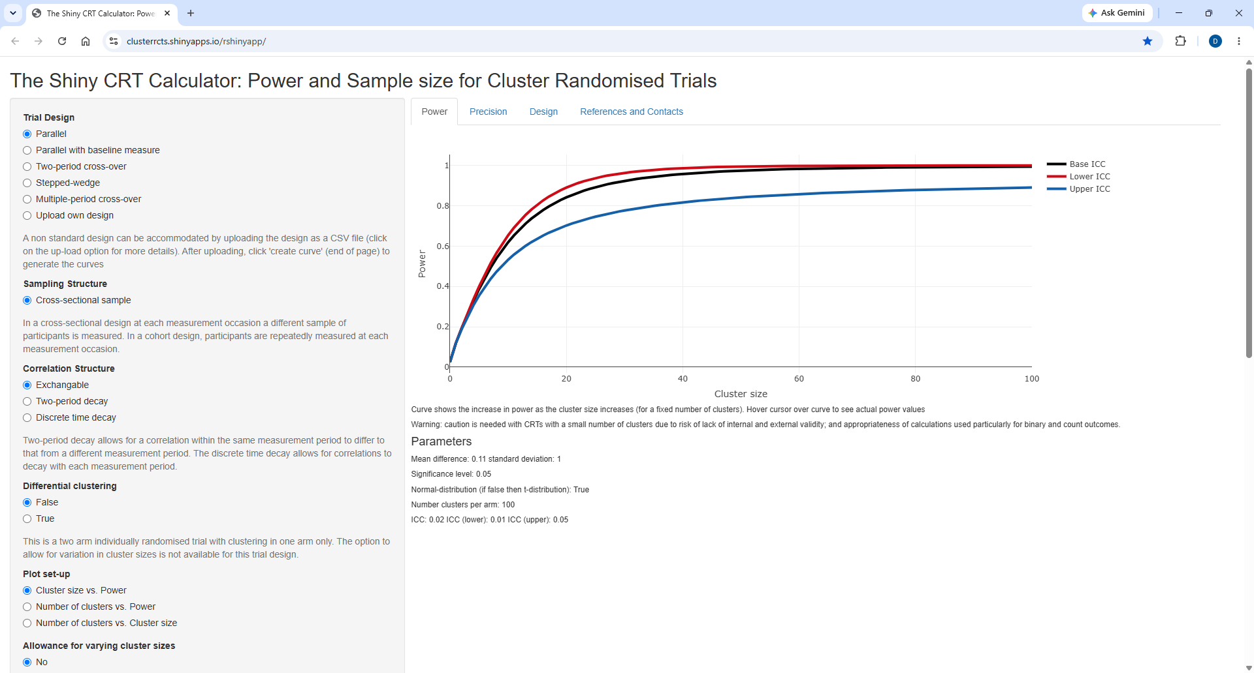
Shiny App for Cluster Randomised Trials
The Shiny CRT Calculator: Power and Sample size for Cluster Randomised Trials

Slide 53
Example using ShinyApp:
Trial Design: Parallel
Correlation Structure: Exchangeable
Differential Clustering: False
Plot Set up: Number of clusters vs. Power
Range of number of clusters: Consider something less than 50
Cluster size= 25, no variability
ICC: 0.05, range 0.01 to 0.1
Continuous outcome, mean difference 3, SD=9.8
Use t-distribution

Slide 54
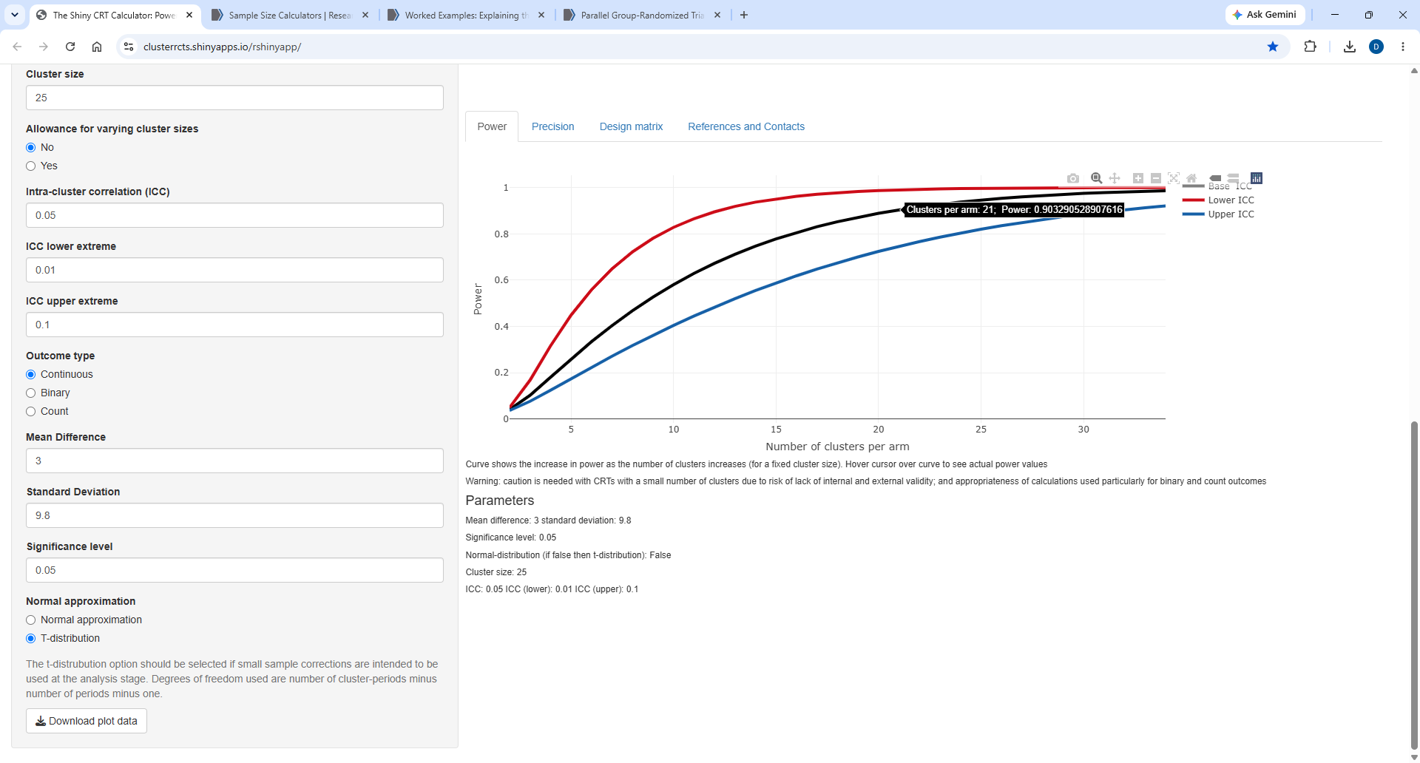

Slide 55
Your turn…
Play around with varying the parameters and see what the output looks like
  See the differences between this App and the NIH App

Slide 56
Can have more than one level of clustering
Examples:
  Participants nested within physicians nested within clinics
  Longitudinal repeated measures of patients nested within clinics
  Cluster, period and repeated measures (stepped-wedge)
Need estimates of ALL levels clustering to design study
  Need separate ICC estimates for each level of clustering
Recall: Sample size is driven primarily by number of clusters and not number of individuals within a cluster – therefore, should prioritize randomizing at lowest level possible to maximize number of clusters
  Example: physicians instead of clinics
Davis-Plourde K, Yu X, Teresi JA. Designing Cluster Randomized Trials: A Practical Guide for Investigators. Med Care. 2026 Apr 1;64(4):179-191. doi: 10.1097/MLR.0000000000002283. Epub 2026 Feb 24. PMID: 41733160; PMCID: PMC13288263.

Slide 57
Parallel Group Design with Baseline
https://www.bmj.com/content/350/bmj.h391

Slide 58
Parallel Group Design with Baseline
Cross-sectional
  Baseline measures are taken on a different group than those randomized
    Example: Rate of intubations on a hospital ward; frailty score for participants in ICU
Cohort
  Baseline measures are taken on the same group as those randomized
    Blood pressure; weight; glucose levels
https://www.bmj.com/content/350/bmj.h391

Slide 59
Example
An investigator is designing a cluster randomized clinical trial with a baseline period to compare two treatments for improving HIV prevention knowledge in at risk youth. The primary outcome of interest is a knowledge score measured at 6 months post intervention. The investigator expected to have an average of 25 youth per site. They believe that a 3-point change on the knowledge score represents a clinically meaningful difference and that prior work with the scale has observed a standard deviation of 9.8. What sample size is needed if we want to power for 90% with a two-sided, type I error of 5%. Assume an ICC of 0.05 from prior work and the individual auto-correlation is 0.5.

Slide 60
R Shiny App
Trial Design: Parallel with baseline measure
Sampling Structure: Cohort
Correlation Structure: Exchangeable
Plot: Number of clusters versus power
Cluster range: 0-30ish
Cluster size: 25
Allow for varying cluster size: No
ICC: 0.05 (0.01 – 0.1)
IAC: 0.5
Outcome: Continuous
Mean Difference: 3
SD: 9.8
Significance: 0.05
Distribution: t

Slide 61
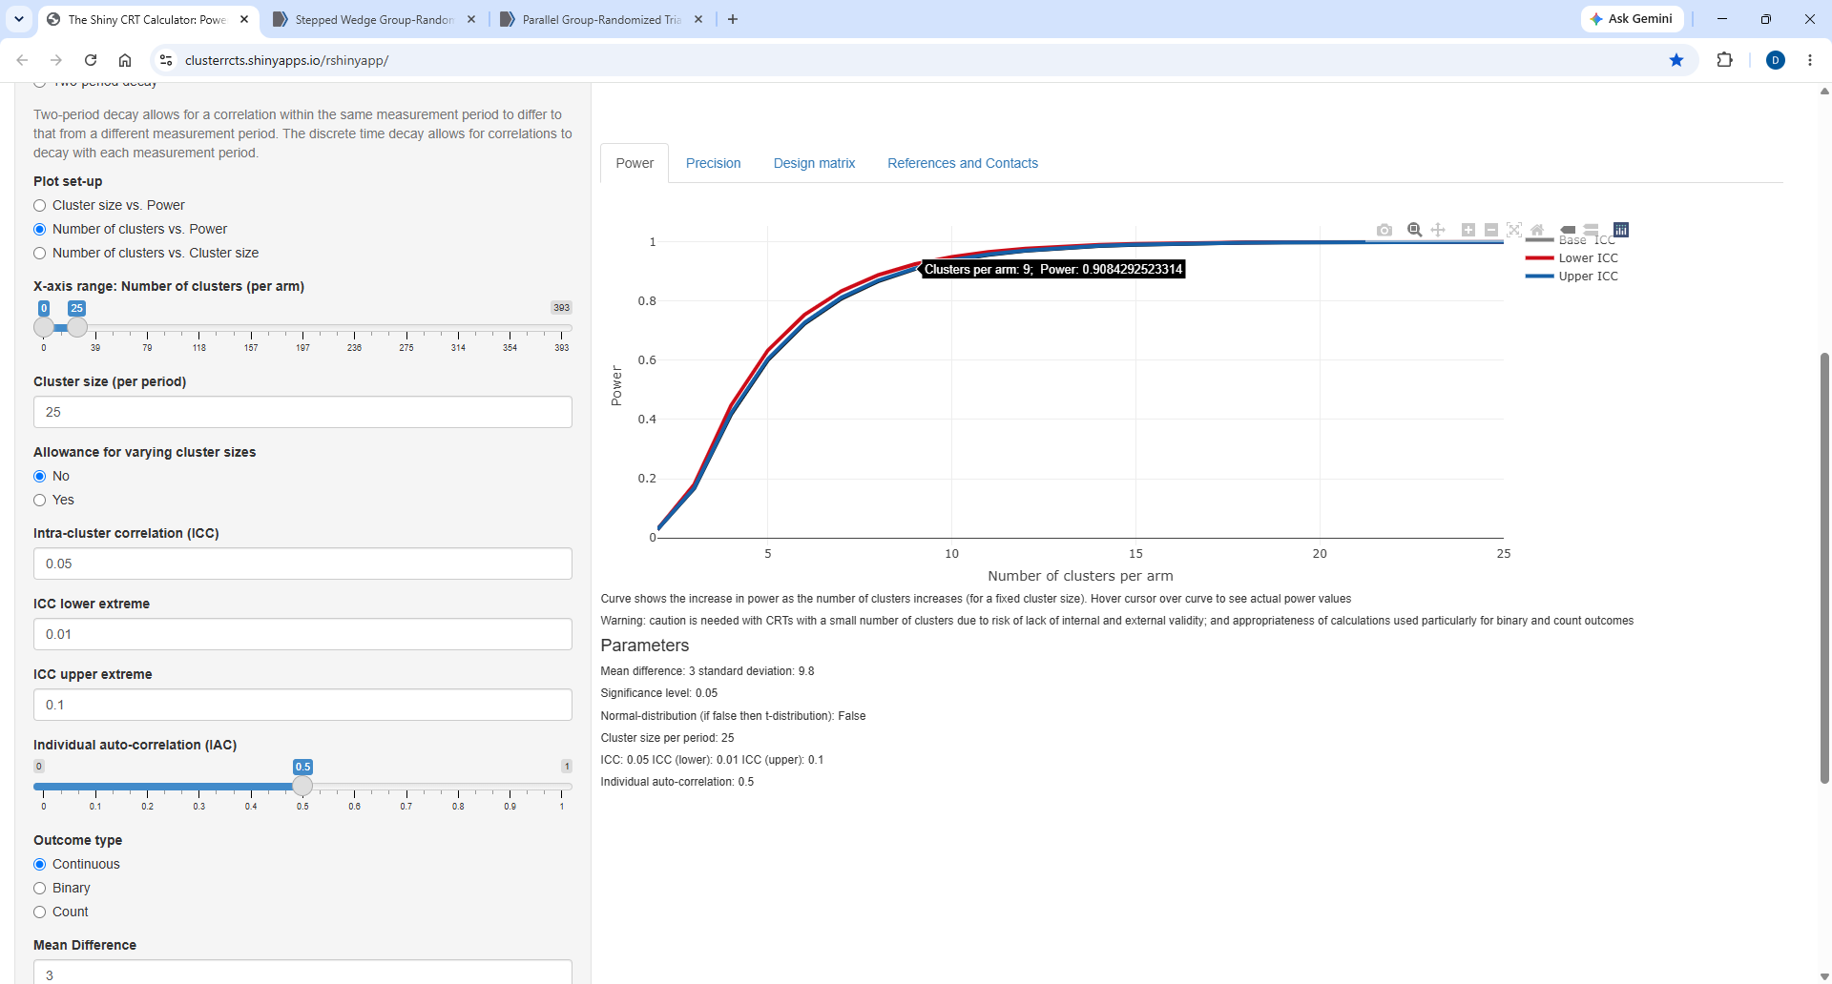

Slide 62
What happens?
When you increase the IAC?
When you decrease the IAC?
If make the same assumptions, but assume cross-sectional sample?
Consider a two-period decay?
  Varying the CAC from 0 to 1.
Decrease the cluster size to 10?
Increase the cluster size to 40?

Slide 63
What happens?
When you increase the IAC?
  Need less clusters
When you decrease the IAC?
  Need more clusters
If make the same assumptions, but assume cross-sectional sample?
  Need more clusters (~15)
Consider a two-period decay?
  Varying the CAC from 0 to 1.
  As CAC increases, need less clusters
Decrease the cluster size to 10? Need more (~19)
Increase the cluster size to 40? Need less (6-7)

Slide 64
Cross-over Designs
Davis-Plourde K, Yu X, Teresi JA. Designing Cluster Randomized Trials: A Practical Guide for Investigators. Med Care. 2026 Apr 1;64(4):179-191. doi: 10.1097/MLR.0000000000002283. Epub 2026 Feb 24. PMID: 41733160; PMCID: PMC13288263

Slide 65
Some Misconceptions about Crossover Designs
Use if unethical to withhold intervention
  But if this is the case, then shouldn’t conduct trial
  Consider a parallel design with a waitlist control
    May allow participants to receive intervention sooner
Use if need to stagger the roll out
  Consider a parallel design with staggered roll out
    Do not need to randomize all clusters in the beginning like a stepped-wedge
Reduce potential for confounding because clusters serve as own control
  Mitigate time-invariant confounding but can introduce time-varying confounding (trading confounding)
  Time can be a potential confounder
  Consider a parallel design with things like covariate constrained randomization to ensure balance; collect baseline outcome data
Davis-Plourde K, Yu X, Teresi JA. Designing Cluster Randomized Trials: A Practical Guide for Investigators. Med Care. 2026 Apr 1;64(4):179-191. doi: 10.1097/MLR.0000000000002283. Epub 2026 Feb 24. PMID: 41733160; PMCID: PMC13288263

Slide 66
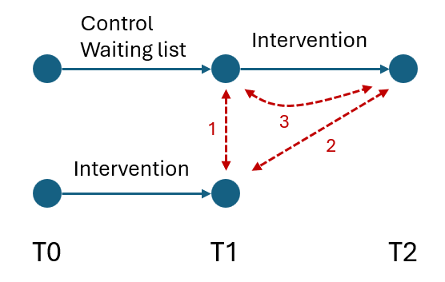
Waitlist control
Participants/clusters are originally randomized to not receive the experimental treatment
Given treatment after the treatment group has completed the study.
Why might one use this type of design?
https://stats.stackexchange.com/questions/654200/appropriate-regression-analysis-for-intervention-study-using-waiting-list-contro

Slide 67
Some Hypotheses to test
Difference in means between intervention and control at time T1.
Difference in means between control at T2 and intervention at T1
Difference in means between control at T1 and T2 (within-group)

Slide 68
Stepped-wedge Cluster Randomized Trial (swCRT)
Pragmatic trial design
Suited for trials that do not rely on individual patient recruitment
All clusters get intervention (more exposed toward end)
  Could end up with time confounding
Design (sample size) needs to account for clustering and confounding effect of time.
  Time effect tends to impact precision → large sample size needed (compared to parallel)
  Contribution of control and treatment data from sample cluster, tends to enhance precision → smaller sample size needed
Small ICC → more power for parallel group CRT compared to swCRT
Large ICC, large clusters → more power swCRT compared to parallel group
Hemming K, Haines T P, Chilton P J, Girling A J, Lilford R J. The stepped wedge cluster randomised trial: rationale, design, analysis, and reporting BMJ 2015; 350 :h391 doi:10.1136/bmj.h391

Slide 69
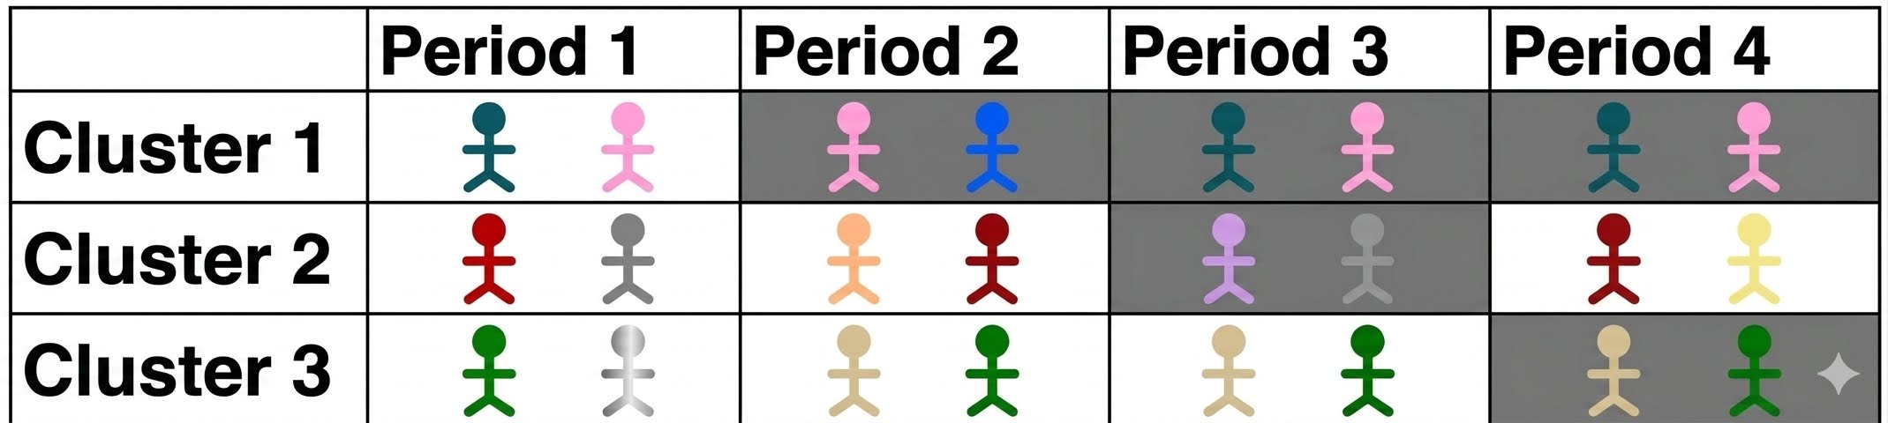
Stepped-wedge cluster design
Closed Cohort
  All subjects participate from beginning to end
Open Cohort
  New subjects can enter, and others can leave (time of exposure varies)
Cross-Sectional
  Subjects are only assigned to treatment or control
From Table 1: Davis-Plourde K, Yu X, Teresi JA. Designing Cluster Randomized Trials: A Practical Guide for Investigators. Med Care. 2026 Apr 1;64(4):179-191. doi: 10.1097/MLR.0000000000002283. Epub 2026 Feb 24. PMID: 41733160; PMCID: PMC13288263.
Open Cohort figure generated from AI

Slide 70
Correlations in Stepped-Wedge Designs
Within-period ICC
  Correlation of different individuals in the same cluster and period
  Equivalent to ICC for a 2-level design
Between-period ICC
  Correlation of different individuals in the same cluster but different periods
  No bigger than the within-period ICC
Between subject ICC
  Correlation of outcomes from the same individual but collected at different periods (closed cohort)
From Table 1: Davis-Plourde K, Yu X, Teresi JA. Designing Cluster Randomized Trials: A Practical Guide for Investigators. Med Care. 2026 Apr 1;64(4):179-191. doi: 10.1097/MLR.0000000000002283. Epub 2026 Feb 24. PMID: 41733160; PMCID: PMC13288263.

Slide 71
Cluster Autocorrelation Coefficient (CAC)
Between period ICC is usually estimate using the following
  ICC_{b}^{|t-s|} = ICC_{w} x r_{ts}
    |t-s| absoluate difference in the number of periods t and the period s
    r_{ts} ratio of ICC_{b} to ICC_{w} when outcomes are |t-s| periods apart
      Implies individuals in same cluster but at different times are still similar, but possibly less so
      Value between 0 and 1, where 0 means ICC_{b}=0 and 1 means ICC_{b}=ICC_{w}
Common assumption is that r_{ts}=r (constant ratio), which implies that ICC_{b}^{|t-s|}=ICC_{b}
  In this situation, r is called the cluster autocorrelation coefficient (CAC)
    ICC_{b} = ICC_{w} x r
Could assume ratio of ICC_{b} to ICC_{w} decays over time by r (decay rate) as outcome measures get further apart r_{ts}=r^{|t-s|}
  ICC_{b}^{|t-s|} = ICC_{w} x r^{|t-s|}
Davis-Plourde K, Yu X, Teresi JA. Designing Cluster Randomized Trials: A Practical Guide for Investigators. Med Care. 2026 Apr 1;64(4):179-191. doi: 10.1097/MLR.0000000000002283. Epub 2026 Feb 24. PMID: 41733160; PMCID: PMC13288263.

Slide 72
Stepped-wedge Cluster Design
ADVANTAGES
CHALLENGES
All units receive the intervention
Helps with resource allocation
Used to reconcile robust evaluation with political or logistical constraints
If substantial cluster-level effects present or have large clusters, stepped wedge will be more powerful than parallel design (more cost efficient)
Contamination
Carry-over effects
Temporal trends (confounding effect of time)
Blinding
Multiple data collection points are required
Complex analyeses
https://trialsjournal.biomedcentral.com/counter/pdf/10.1186/s13063-015-0842-7.pdf
.

Slide 73
Example:
An investigator is designing stepped-wedge trial to test whether adding an alert to electronic health record data for smokers will increase the prescription of tobacco replacement therapy. The investigators believe that without any alert, 5% of smokers will receive a prescription for tobacco replacement therapy and that alerts will increase that rate to 15%. The investigators have 12 clinics that are willing to participate. These clinics see on average 100 smokers every 6 months. They will be able to conduct the study for no more than 3 years.

Slide 74
r=correlation between two sample means from the same cluster at different times
u=Number of baseline assessment
v= Number of follow-up assessment
w=Number of steps
Hooper R, Bourke L. Cluster randomised trials with repeated cross sections: alternatives to parallel group designs. BMJ. 2015 Jun 8;350:h2925. doi: 10.1136/bmj.h2925. PMID: 26055828.
Notes:
Potential design choices

Slide 75
Example (from Hooper and Bourke):
Murphy and colleagues evaluated a free school breakfast program in Wales using a cluster randomized trial with schools as clusters
At each of 111 schools, a baseline sample of about 50 children aged 9-11 years completed assessments of behavior, cognitive performance and diet.
Half were randomized to intervention and the other to control.
One year later, a new sample of children aged 9-11 was taken at each school.
Hooper R, Bourke L. Cluster randomised trials with repeated cross sections: alternatives to parallel group designs. BMJ. 2015 Jun 8;350:h2925. doi: 10.1136/bmj.h2925. PMID: 26055828.
Murphy S, Moore GF, Tapper K, et al. Free healthy breakfasts in primary schools: a cluster randomised controlled trial of a policy intervention in Wales, UK. Public Health Nutr 2010;14:219-26.

Slide 76
Expected Results
Design | Schools | Participants | # Follow-up Times | # Measurement Times
Parallel Group | 104 | 5200 | 1 | 1
Parallel Group with Baseline | 88 | 8800 | 1 | 2
Stepped Wedge (2 steps) | 80 | 12000 | 2 | 3
Stepped Wedge (3 steps) | 48 | 9600 | 3 | 4
Stepped Wedge (4 steps) | 36 | 9000 | 4 | 5
Note: Only the Parallel group does not require an extra baseline measure
Think about the potential tradeoffs and cost implications of the above design choices
Hooper R, Bourke L. Cluster randomised trials with repeated cross sections: alternatives to parallel group designs. BMJ. 2015 Jun 8;350:h2925. doi: 10.1136/bmj.h2925. PMID: 26055828.
Murphy S, Moore GF, Tapper K, et al. Free healthy breakfasts in primary schools: a cluster randomised controlled trial of a policy intervention in Wales, UK. Public Health Nutr 2010;14:219-26.

Slide 77
Example:
Use the SWGT calculator to try and reproduce the results for the 2 step designs
Sample Size Calculators | Research Methods Resources

Slide 78
Individually Randomized Group Treatment (IRGT) Trials

Slide 79
Individually Randomized Group Treatment (IRGT) trials
Individual level randomization, but clustering is introduced after randomization by nature of the treatment
  Examples: Behavioral interventions, surgical trials
Clustering could be introduced in one or all the arms in the study
  Partially Nested: One arm (usually intervention) receives intervention in groups, but the other arm (usually control) does not (receives individually)
  Fully Nested: Different providers or groups are used in both treatment and control arms
  Crossed: Providers treat participants in both arms (if case load is balanced, clustering can be ignored)
Membership structure
  Can have complex structures or groups
    Example: wHOPE study
Seal KH, Morasco BJ, Martin AM, Reddy KP, Van Iseghem TM, Bolton RE, Bokhour BG, Murphy J, Denneson LM, Esserman D, Buta E, Purcell N, Bertenthal D, Painter JT, Abadjian LR, Moore LC, Chan AC, McCamish N, Maguen S, Neylan TC, Gibson CJ, Becker WC; wHOPE Study Group. The Veterans Affairs' Whole Health Approach for Chronic Pain Management: The wHOPE Randomized Clinical Trial. JAMA. 2026 May 26;335(20):1774-1786. doi: 10.1001/jama.2026.5006. PMID: 42054020; PMCID: PMC13130068.

Slide 80
Example:
Investigators are interested in conducting a pragmatic clinical trial at 4 clinics. Individuals at high risk for contracting HIV will be individually randomized to receive health coaching versus standard of care to increase PrEP uptake at 6-months. The baseline rate of PrEP uptake is expected to be 10% and we expect to see at least a 15% absolute improvement. The investigators would like to design the study with 90% power and a two-sided, type I error rate of 5%. The ICC in the coaching arm is expected to be 0.025. Each clinic can have 3-6 health coaches. And each coach can manage a maximum of 15 participants over the course of the study. We want to conduct a 1:1 randomization. Prefer less health coaches and more participants per health coach. Do not need the same number of coaches per site but want at least 3.

Slide 81
Example:
If want to randomize 1:1, how many participants should be enrolled in each arm, and how many coaches should be recruited?
NOTE: May get to the same “answer” with different combinations.

Slide 82
One potential solution
Type I error= 0.05; Power=90%
Proportion with event (0.1+0.25)/2 = 0.175
Simple difference; partially nested
ICC= 0.025
14 groups (coaches)
15 people per coach
Since 1:1 then 15*14 = 210 (in control arm)
No adjustment for regression (could consider site)
Effect size = 0.15

Slide 83
Output
 | 7 Groups in the Intervention Condition | 11 Groups in the Intervention Condition | 14 Groups in the Intervention Condition | 21 Groups in the Intervention Condition | 28 Groups in the Intervention Condition
53 Members in the Control Condition | 0.2505 | 0.2311 | 0.2233 | 0.2133 | 0.2080
105 Members in the Control Condition | 0.2087 | 0.1856 | 0.1761 | 0.1638 | 0.1572
210 Members in the Control Condition | 0.1843 | 0.1580 | 0.1469 | 0.1321 | 0.1240
420 Members in the Control Condition | 0.1710 | 0.1424 | 0.1301 | 0.1131 | 0.1036
840 Members in the Control Condition | 0.1640 | 0.1340 | 0.1208 | 0.1024 | 0.0919
Have 90% power for a 14.7% effect size.
Thus, would have > 90% power for a 15% effect size. (91.2%)

Slide 84
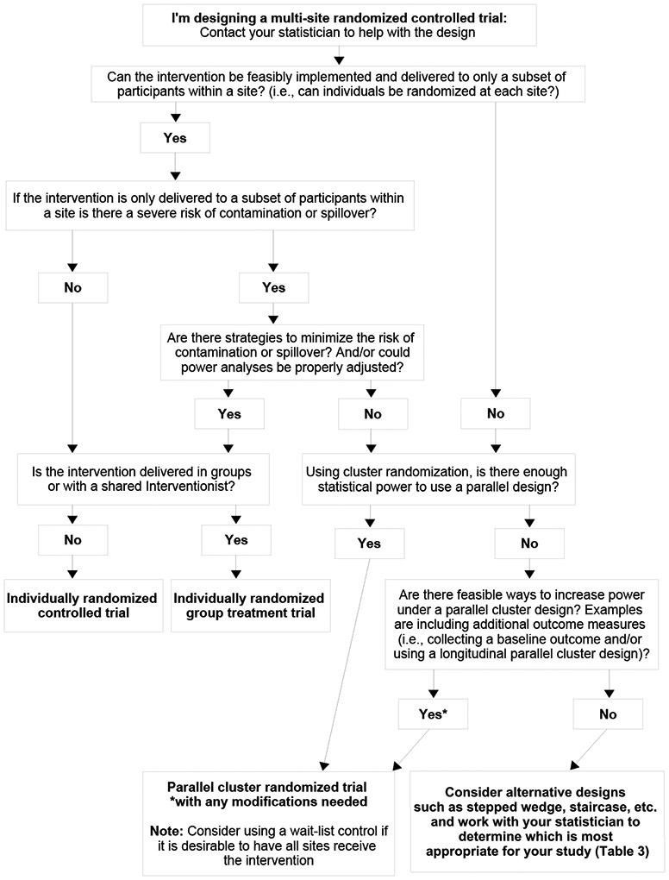
How to help make a decision on design choice?
Figure 1 from Davis-Plourde K, Yu X, Teresi JA. Designing Cluster Randomized Trials: A Practical Guide for Investigators. Med Care. 2026 Apr 1;64(4):179-191. doi: 10.1097/MLR.0000000000002283. Epub 2026 Feb 24. PMID: 41733160; PMCID: PMC13288263.

Slide 85
Own Design
Creating a design matrix
  Suppose you want to conduct a staircase design instead of a stepped wedge design.

Slide 86
What we did not get a chance to cover
We have mainly focused on continuous outcomes, some binary outcomes, but the Shiny App can also handle count outcomes.
Cross-over studies
  Two-period
  Multiple-period

